Slide 1
Citizens’ Bond Oversight Committee
Measure GC Progress Report
Glendale Community College
Project Updates
February 3, 2025
Presented by
Silva Sorkazian, Interim Assistant Facilities Director
Bond Projects & Construction

Slide 2
Measure GC & Bond Priorities Report Through January 31, 2025
Current Financial Status
Measure GC through January 2025
Original Budget | $328,320,857
Adjusted Budget | $333,385,267
Encumbrance Total | $312,897,442
Unencumbered Funds | $16,203,745
Spent to Date | $300,477,508
Program Reserve | $4,284,080

Slide 3
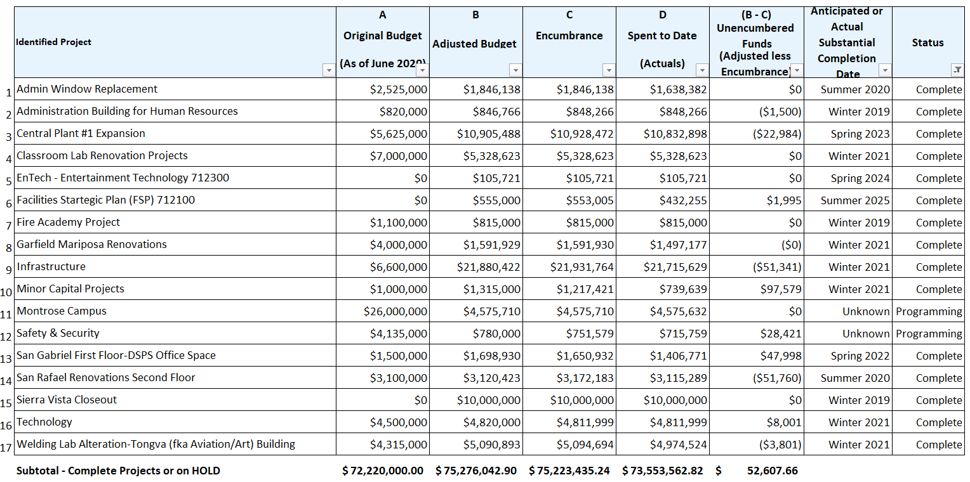
Measure GC & Bond Priorities Report Through January 31, 2025
Completed Projects

Slide 4
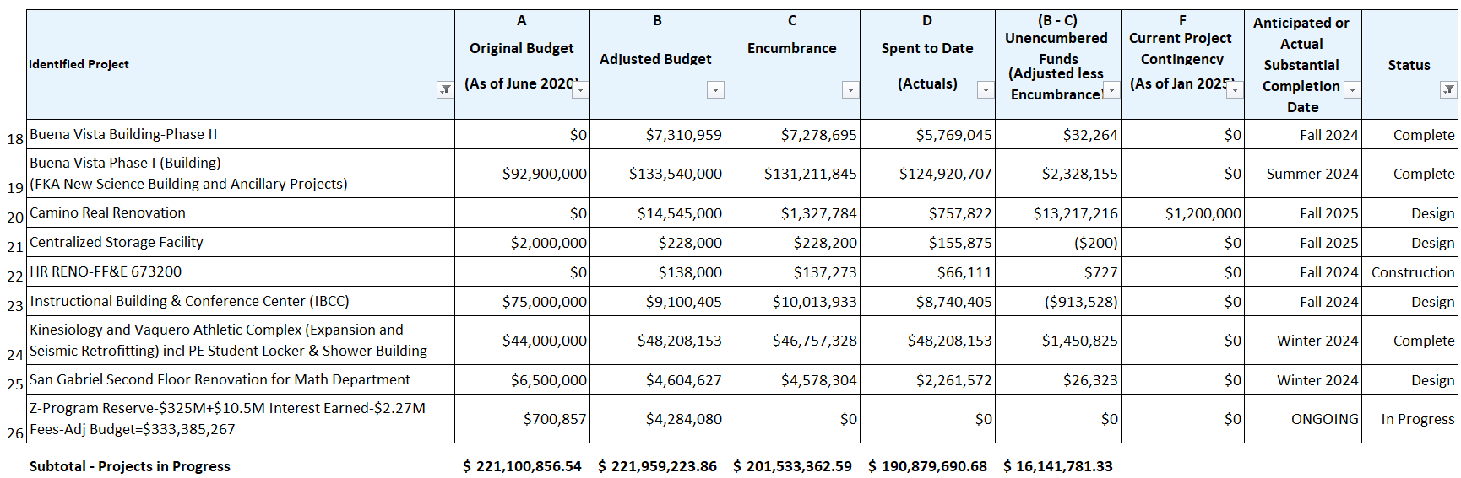
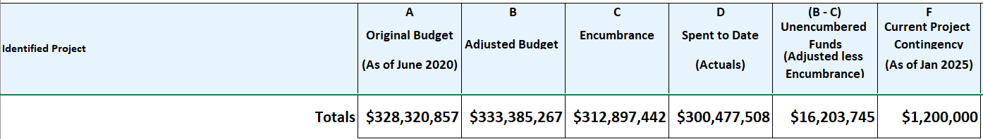
Measure GC & Bond Priorities Report Through January 31, 2025
Projects In Progress

Slide 5
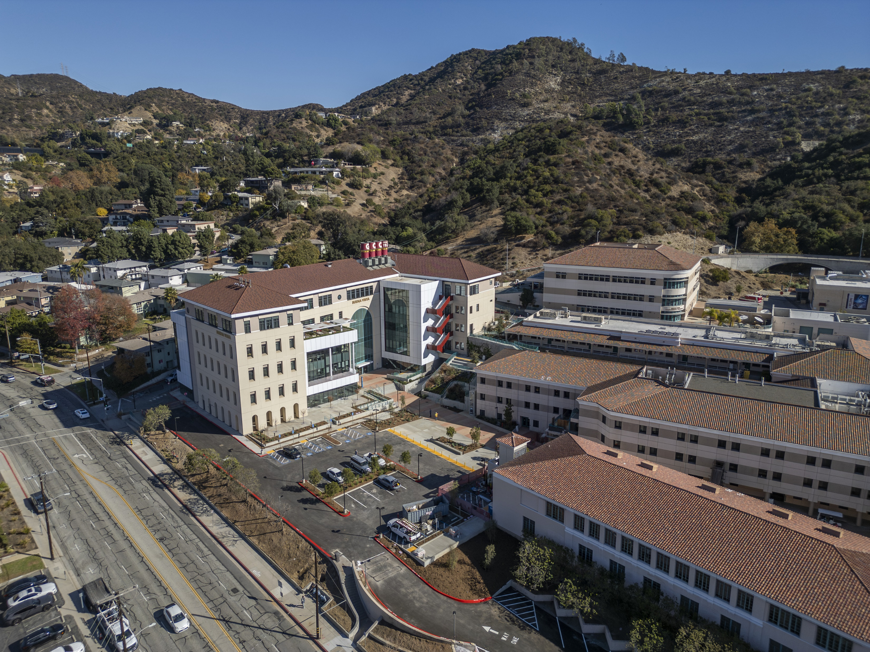
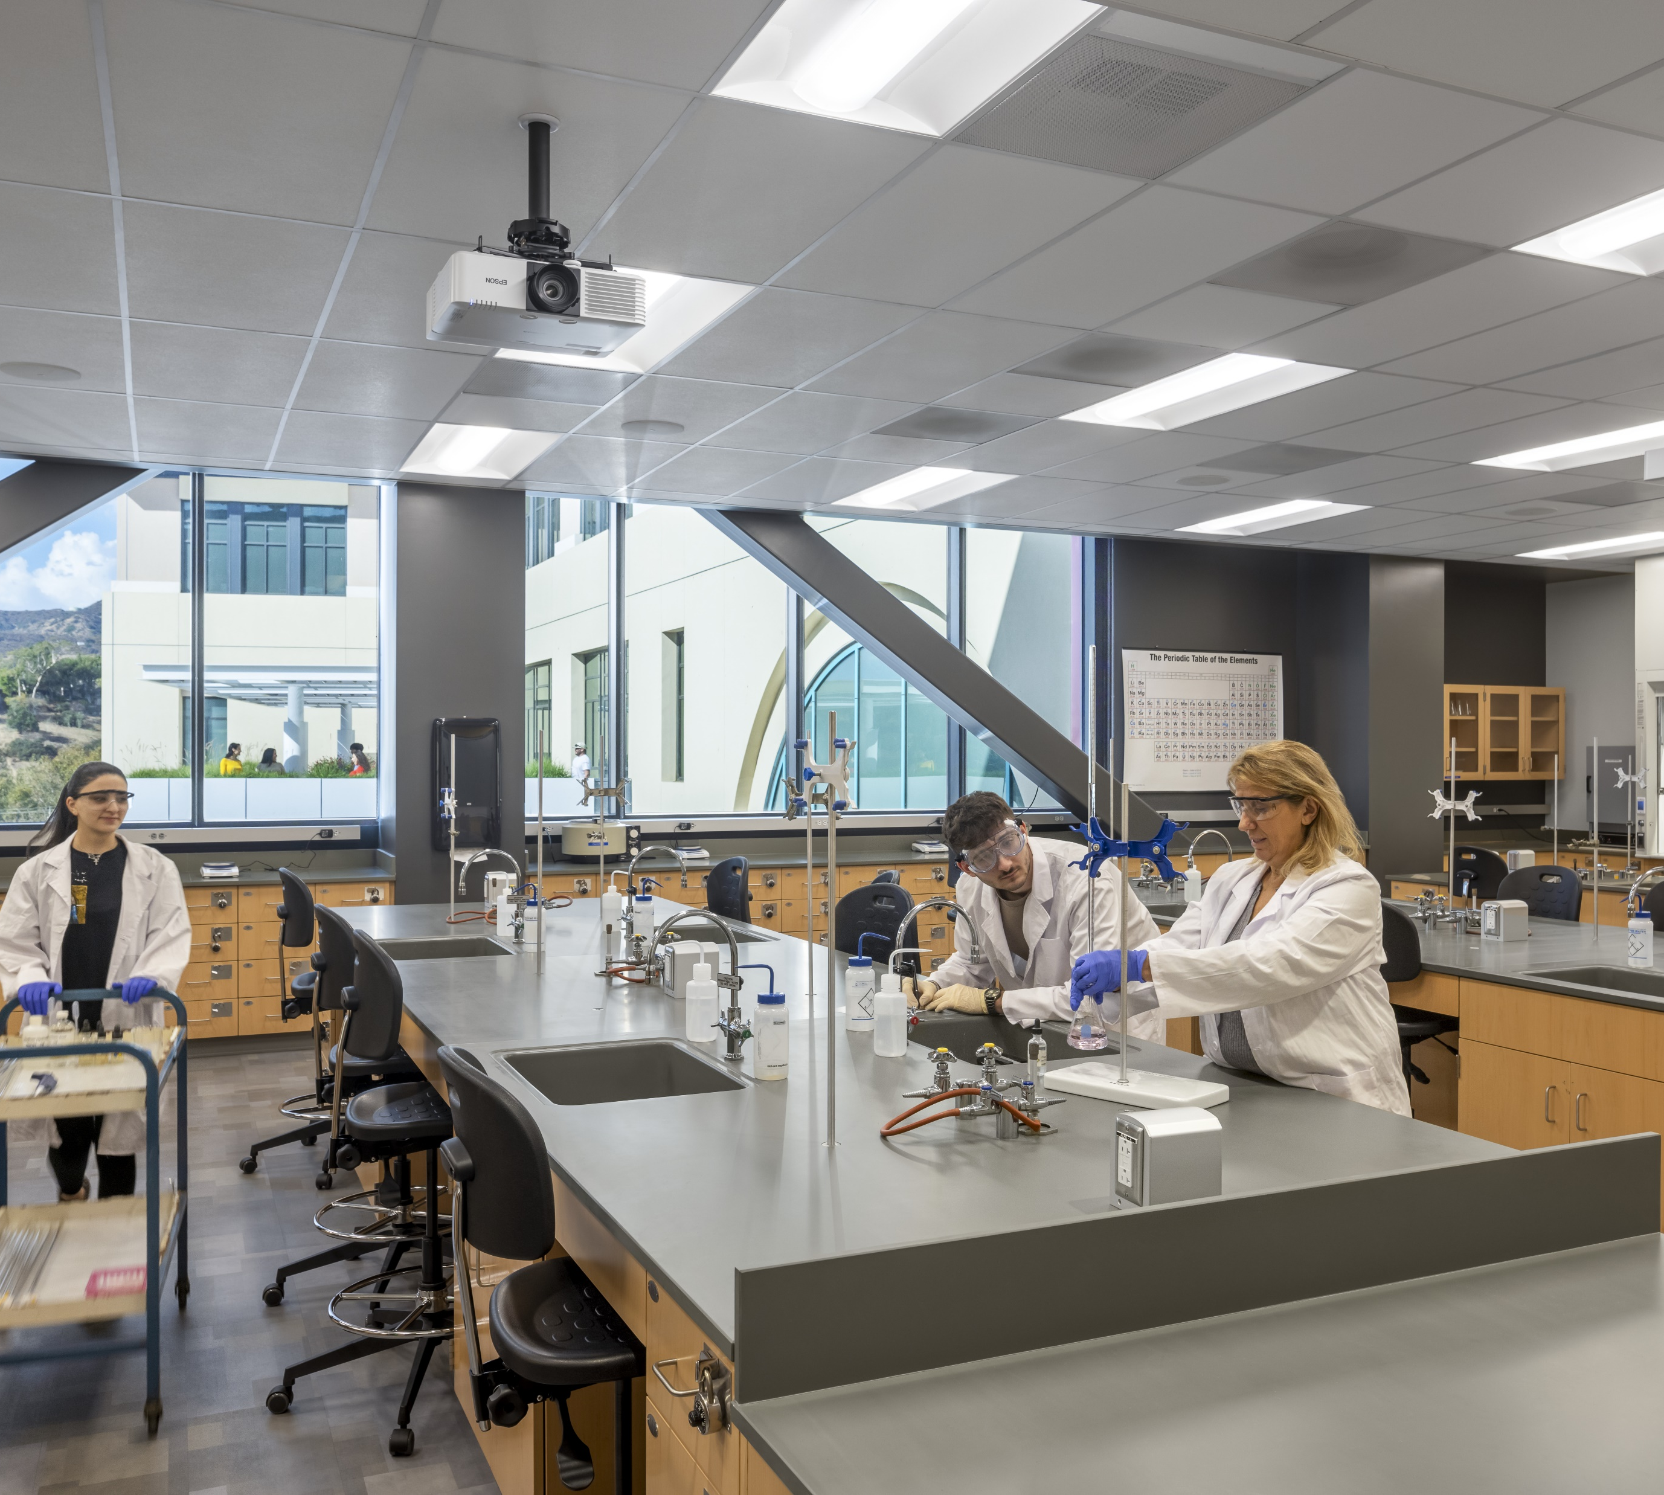
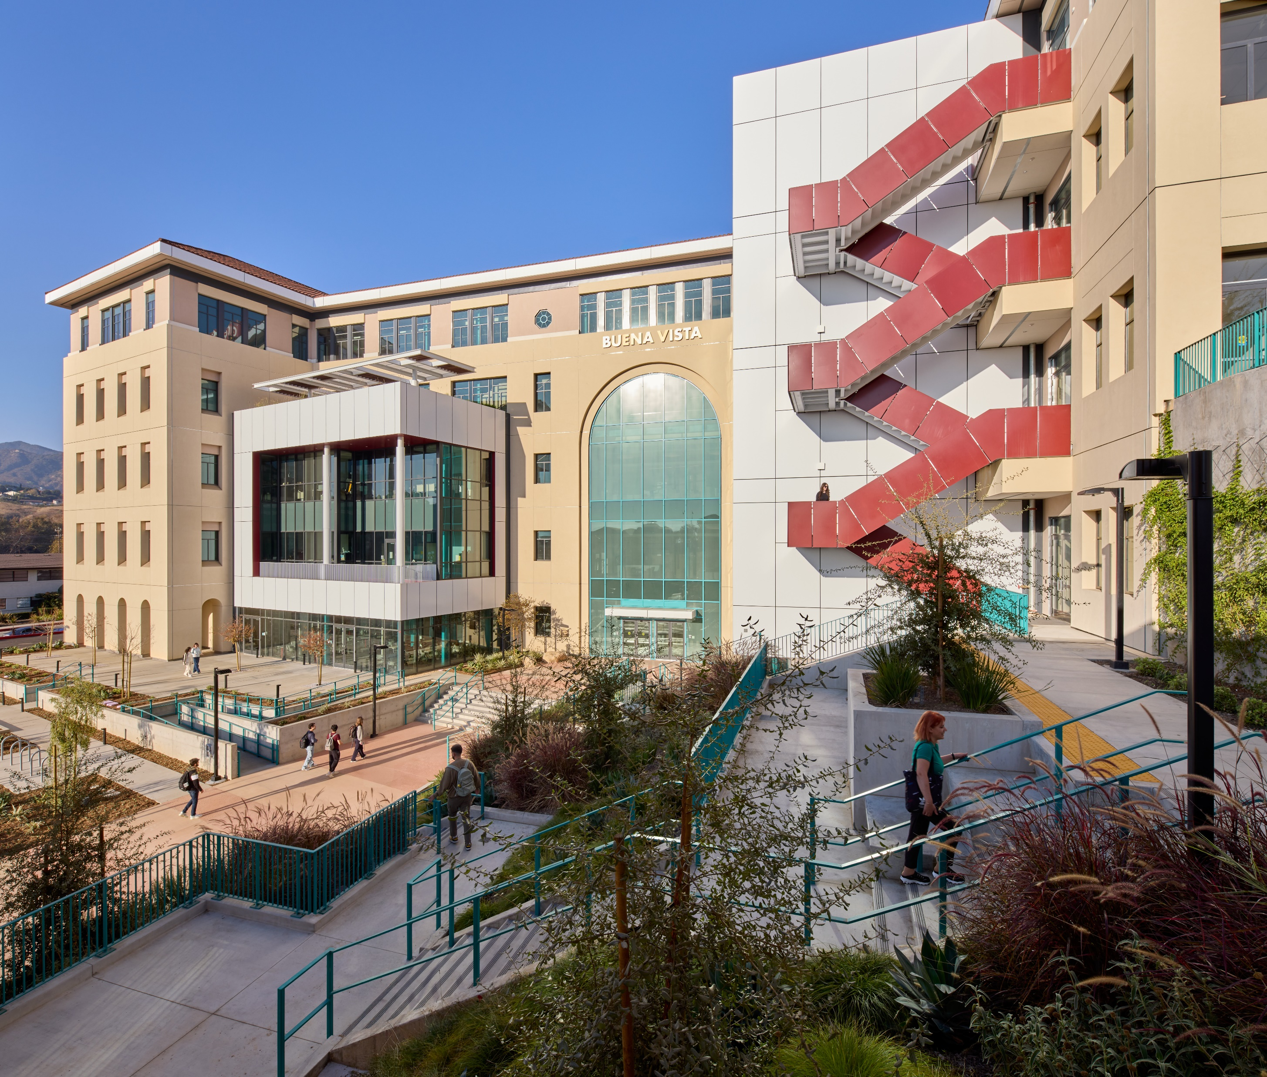
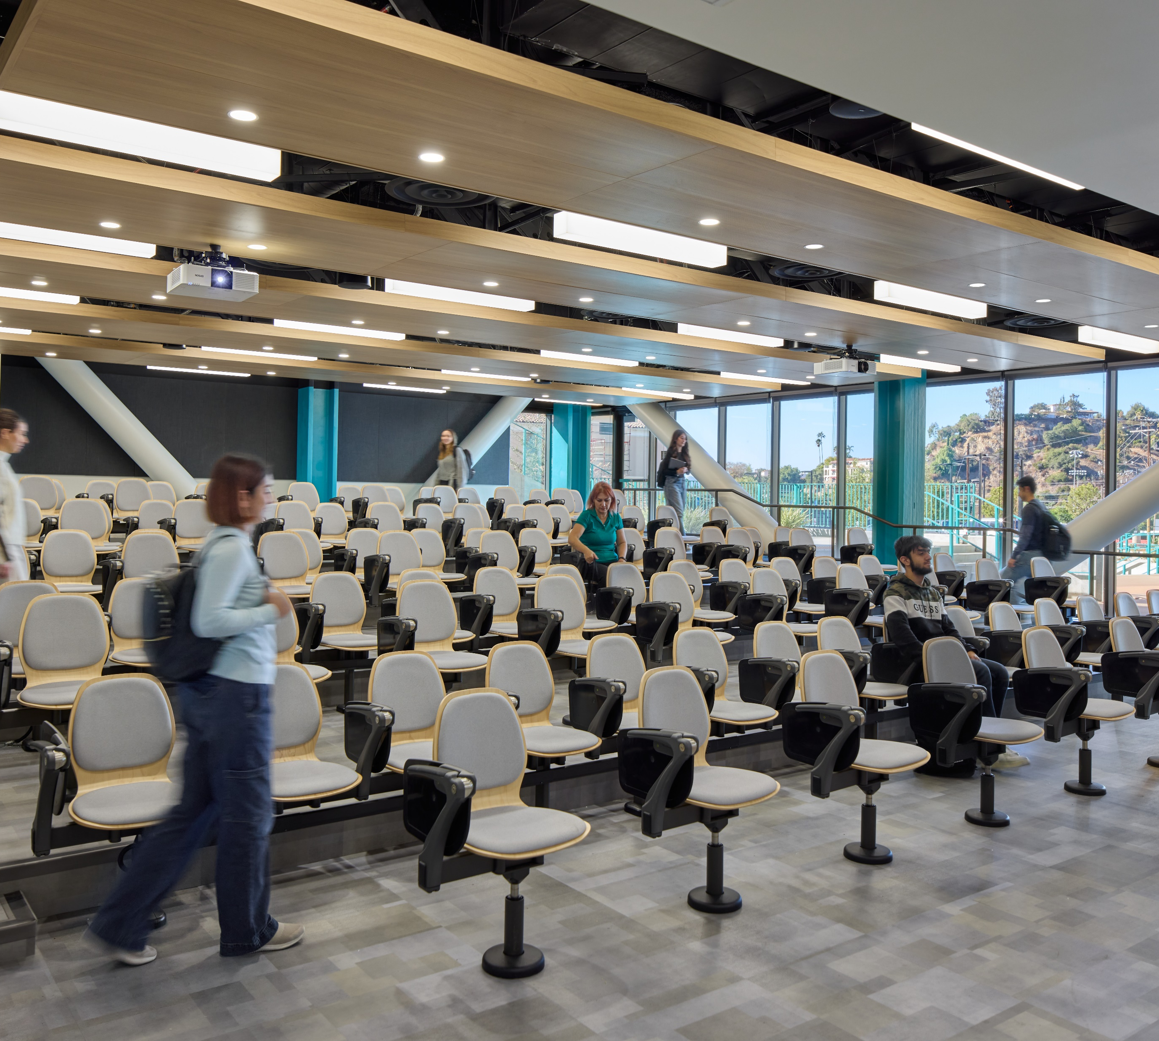
Buena Vista (FKA New Science Building)
Description:
Phase I: Building Structure
          99% complete
          Construction Start – March 2021
        Substantial completion & Occupancy Spring 2024 (Feb 21, 2024)
        DSA Certification efforts in progress for Phase I & II
  Phase II: Demolition, Accessible Parking, ADA POT
        99% complete
        Construction Start – March 2024
        Target Completion – November 2024
        Final Striping scheduled for Nov 22, 2024
Ancillary projects tracked under separate budgets:
  Central Plant 1 connected for Chilled Water; Complete
  Centralized Storage Facility incorporated on ground floor pending Measure GC fund availability to proceed
Key Milestone Completion Dates
Feb 21, 2024 Beneficial Occupancy for Spring 2024 Semester
June 13, 2024 Ribbon Cutting Celebration & Building Opening
Jan 6, 2025 Circle Drive & Campus Way Road resurfacing complete
Jan 24, 2025 All project elevators operable and state certified
Jan 30, 2025 SWRCB Notice of Termination (NOT) Approved
Total Project Status: Construction 99% Complete
Project Budget-Total Estimated at Completion: $132.8 M

Slide 6
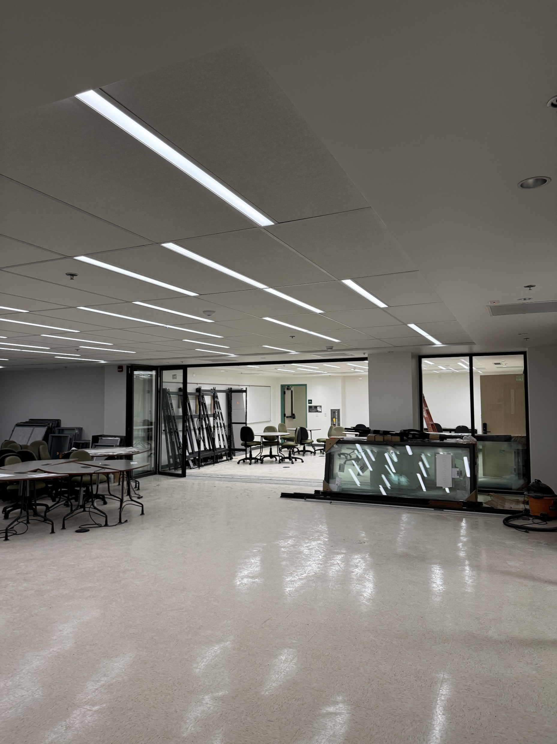
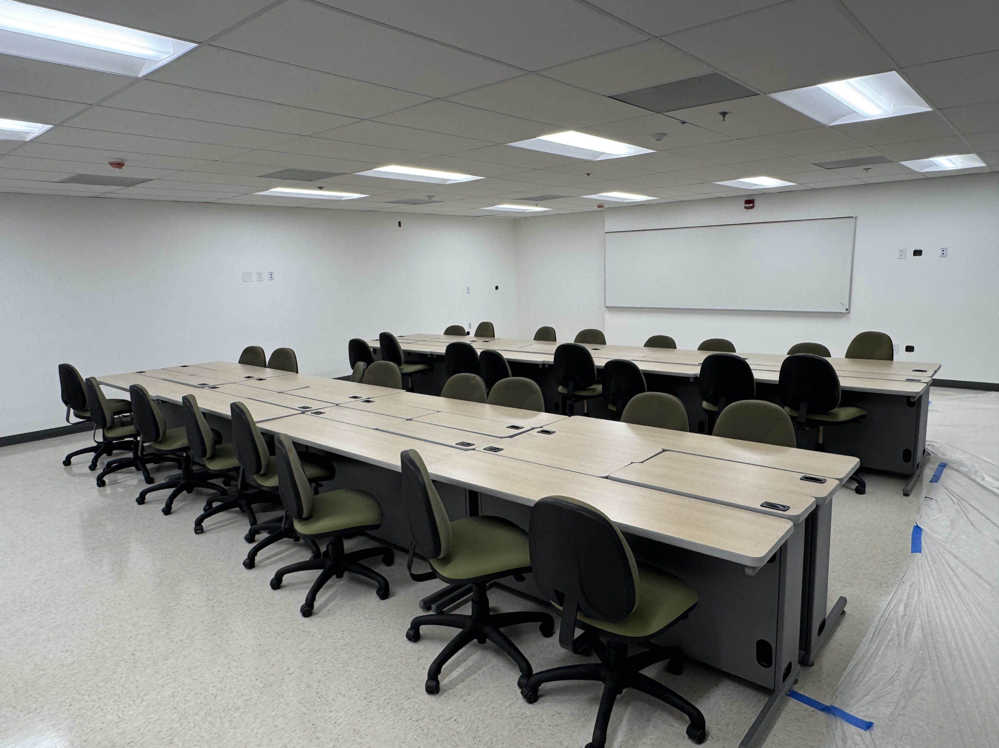
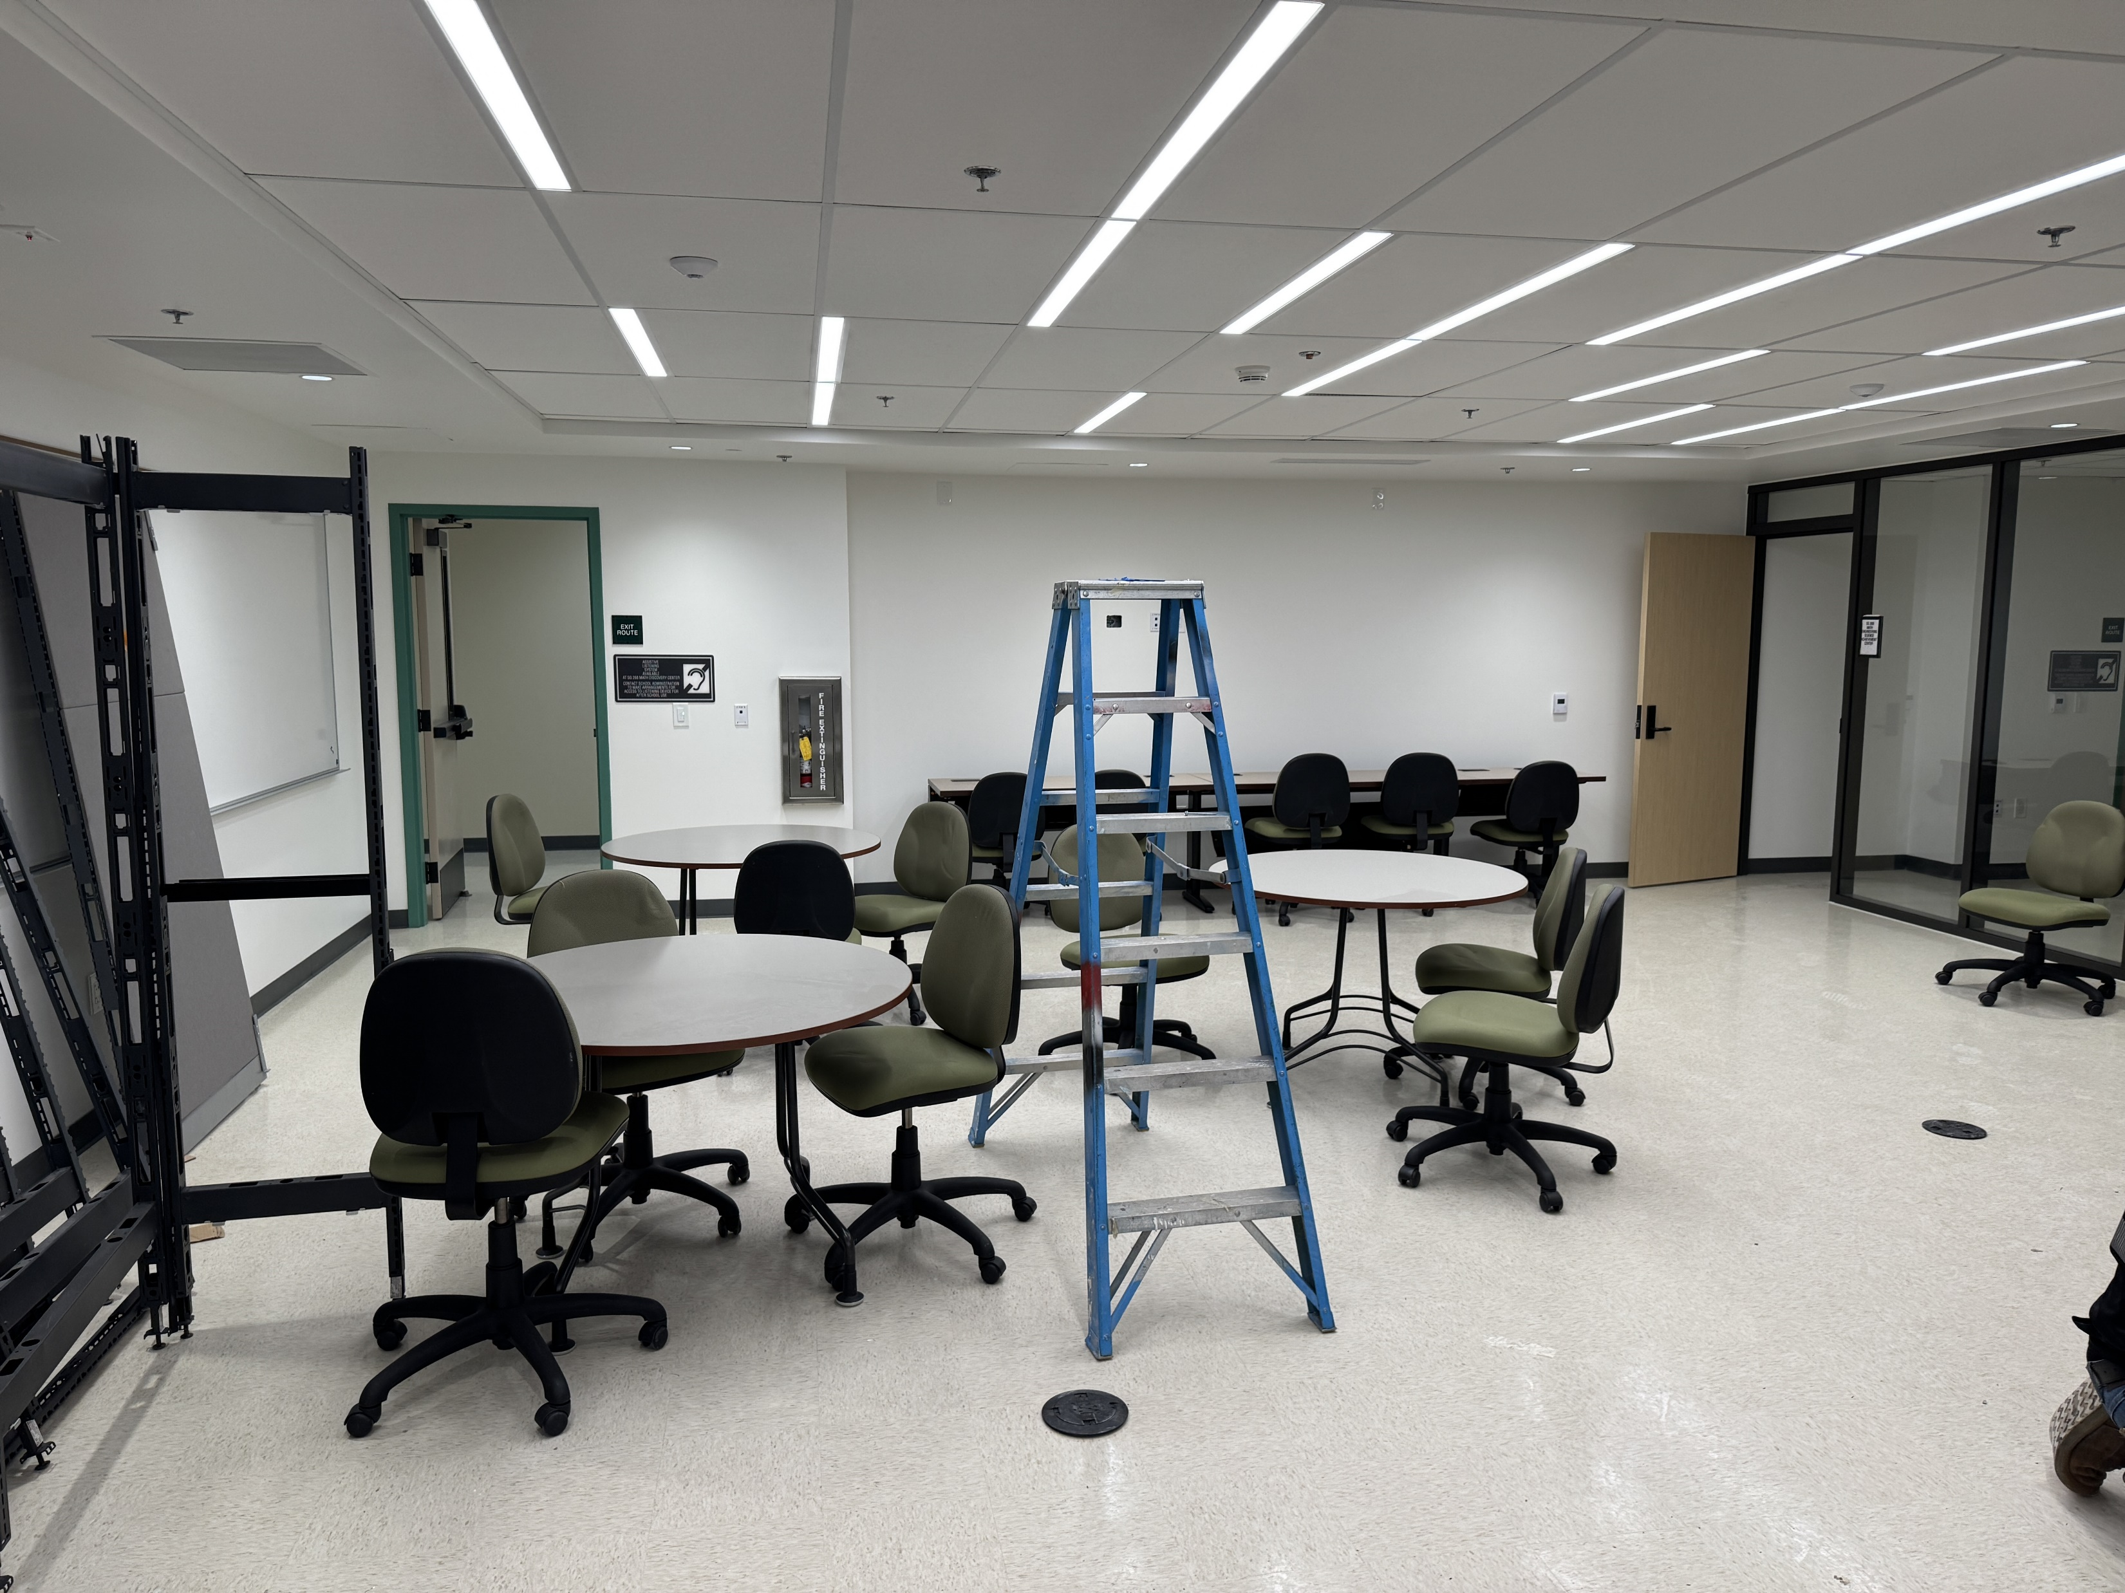
San Gabriel Renovations L2 - Math Department
Description:
Renovate 2nd floor of San Gabriel Building for Math into state-of-the-art math classrooms and labs, including Math Discovery Center
Experienced significant cost increase due to unforeseen causes, abatement issues, omitted plumbing & structural scope
  Construction Progress:
  Nov 18, 2024 Substantial Completion Date
  Jan 29, 2025 Existing Furniture Move-in
  Jan 31, 2025 Sliding Glass Partition Installation
  Feb 19, 2025 BKM Furniture Delivery
  Feb 28, 2025 Final Completion; Phased Move-in
  Project Status: Construction 98%
Project Budget-Total Estimated at Completion: $4.58M

Slide 7
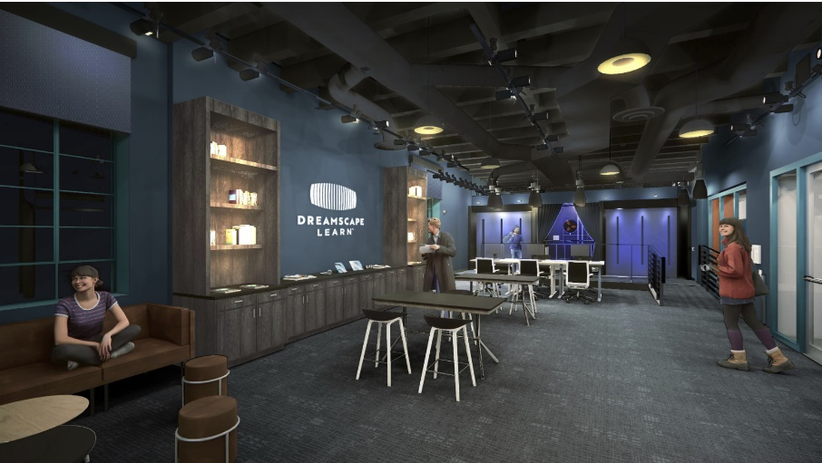
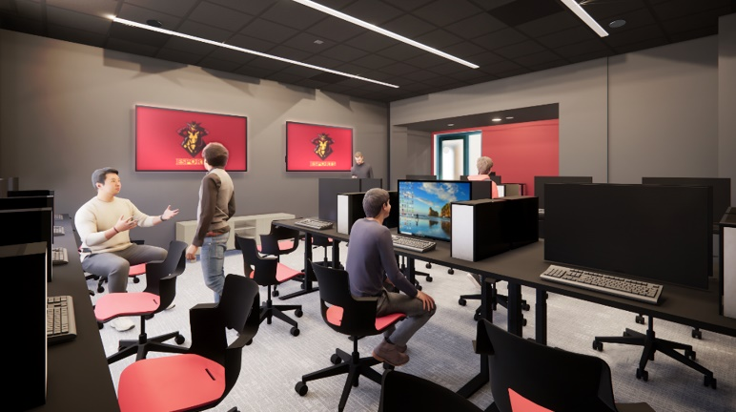
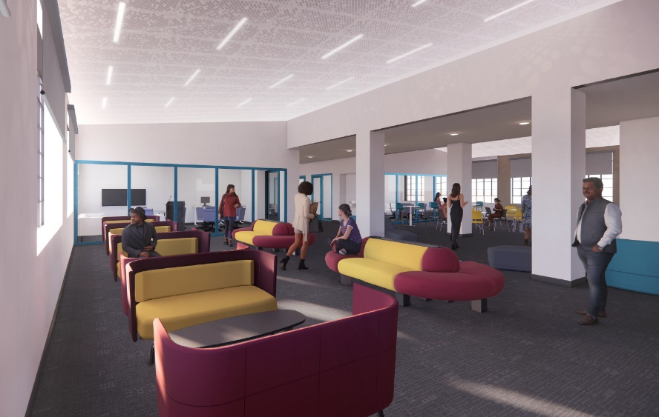
Camino Real Building Renovation
Description:
  Design began September 2023
  Existing Building is 2 floors, located on the North West side of the Verdugo Campus
  Renovation of 17,660 gsf to begin once occupants relocate to Buena Vista Building (Spring-Feb 2024)
  Occupants: Dreamscape Virtual Reality (VR), Sandbox, Maker space and Esports, Student Inclusion
  Schedule Update:
  HUD - Form 50.4 (CEST) Public Review Exemption
  Feb 2025 DSA backcheck comments / approval expected
  RFQ/P Timeline
                Feb 2025 Bid solicitation
                Mar 18, 2025 BOT Approval – Notice to Proceed (NTP)
                9-12 Mo Construction Duration (Aggressive)
  Target Substantial Completion is Fall 2025 (Dec 2025)
Supplementary Funding:
Senator Anthony Portantino $4.5M for Licensing & Virtual Reality Equipment
Congressman Adam Schiff $1.5 M - Student Success (earmarked);
Project Status: Design 98% Complete
Project Budget-Total Estimated at Completion: $14.5M

Slide 8
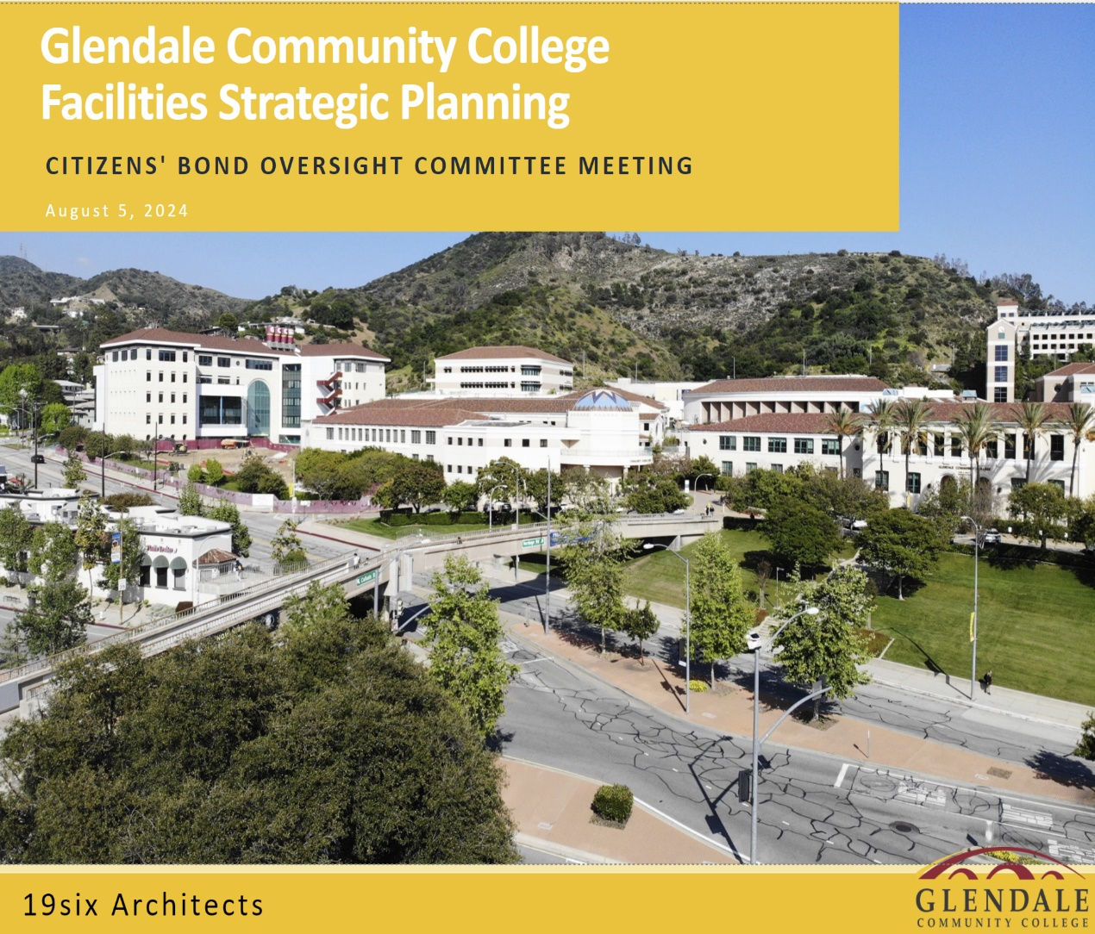
Facilities Strategic Plan (FKA Facilities Master Plan)
Project Updates: Nov 18, 2024 – Board of Trustees Approved Link to 2024 -2035 Facilities Strategic Plan – FINAL (Abridged) Auditorium – Programming in Progress Initial Project Proposals (IPP) / Final Project Proposals (FPP) Jan / Feb 2025 - Programming with user groups May 2025 - Patrick run proposal through Campus Development June 2025 – Present to Board of Trustees (BOT) for Approval Approval for Governor’s 2027/2028 budget Project Status: 99% Complete Project Budget-Total Estimated at Completion: $555,000
2024 -2035 Facilities Strategic Plan - FINAL | The 2025-2035 Facilities Strategic Plan - DRAFT as presented to the Board of Trustees on July 26, 2024

Slide 9
For more up to date information, please visit:
https://www.glendale.edu/campusprojects
Q & A

