Slide 1
Citizens’ Bond Oversight Committee
Measure GC Progress Report
Glendale Community College
Project Updates
May 5, 2025
Presented by
Silva Sorkazian, Interim Assistant Facilities Director
Bond Construction Projects

Slide 2
Measure GC & Bond Priorities Report Through April 29, 2025
Current Financial Status
Measure GC | Funds thru January 31, 2025 | Funds thru April 29, 2025
Original Budget | $328,320,857 | $328,320,857
Adjusted Budget | $333,340,267 | $333,340,267
Encumbrance Total | $312,897,442 | $321,613,065
Unencumbered Funds | $16,203,745 | $11,727,360
Spent to Date | $300,477,508 | $304,173,902
Program Reserve | $4,284,080 | $7,150,000

Slide 3
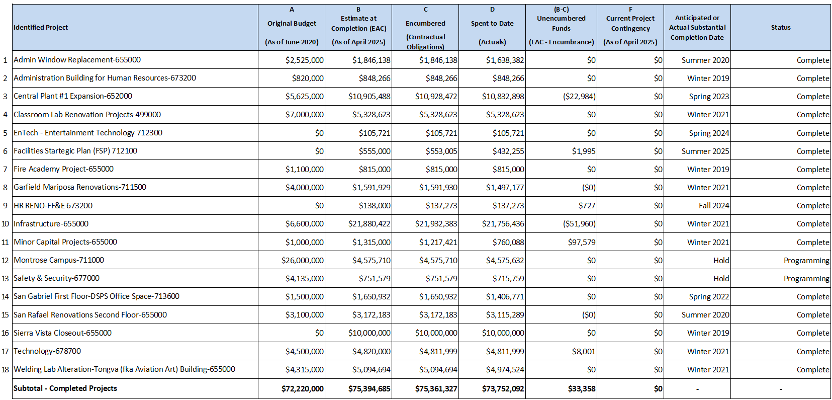
Measure GC & Bond Priorities Report Through April 29, 2025
Completed Projects

Slide 4
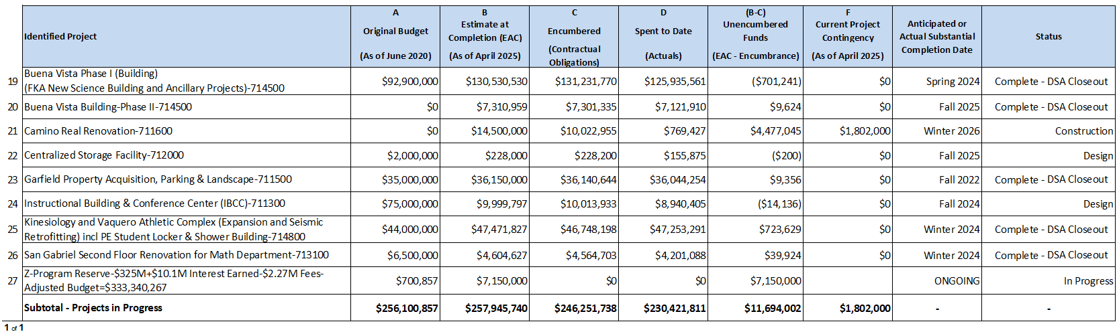
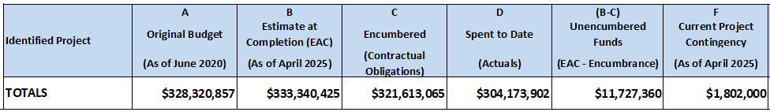
Measure GC & Bond Priorities Report Through April 29, 2025
Projects In Progress

Slide 5
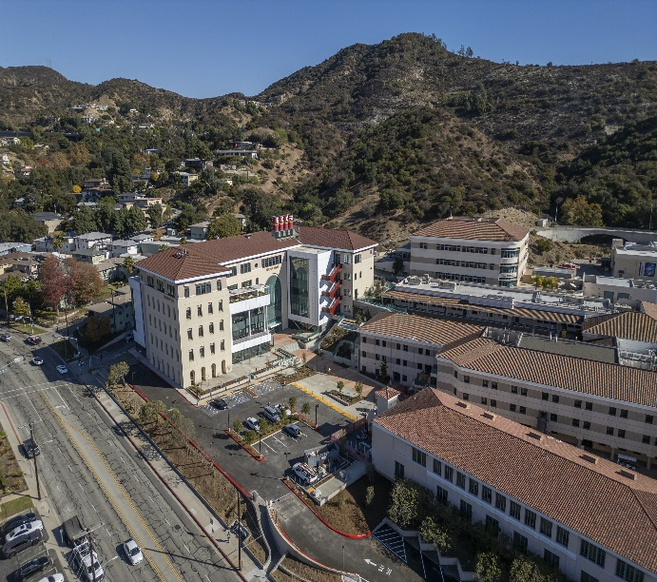
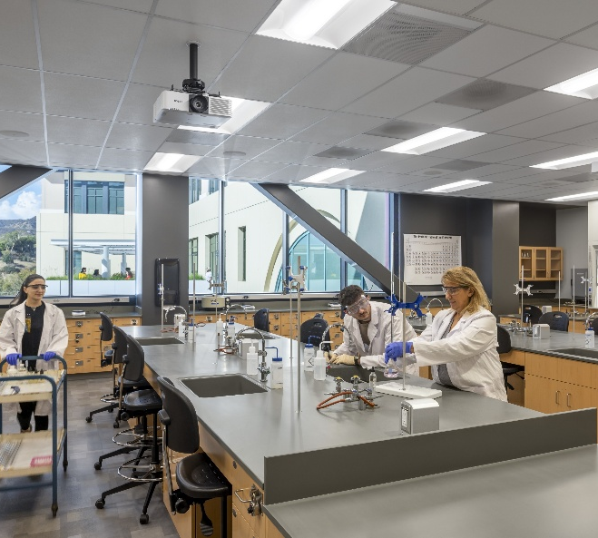
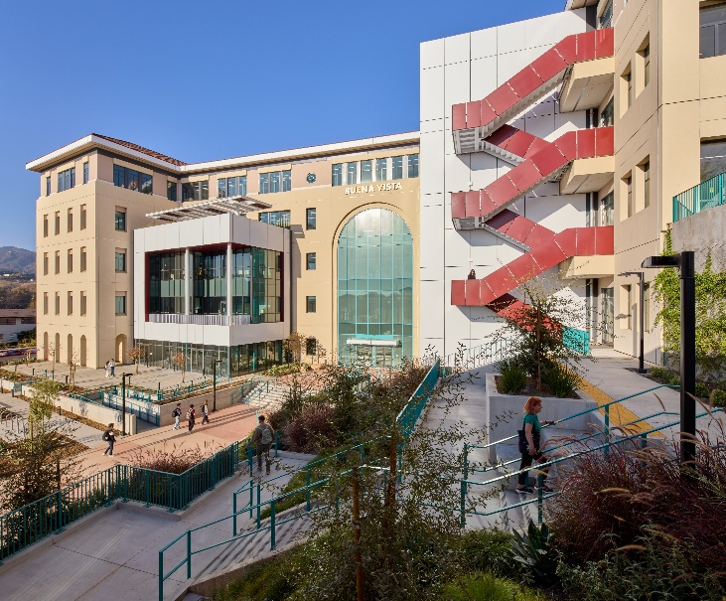
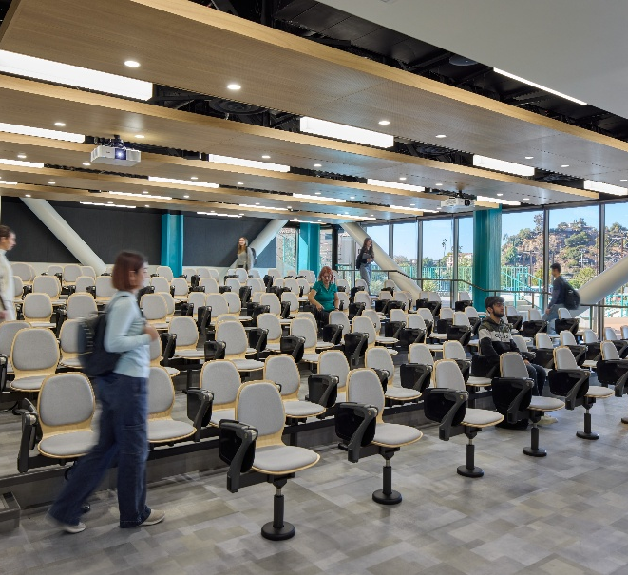
Buena Vista (FKA New Science Building)
Description:
Phase I: Building Structure
          100% complete
          Construction Start – March 2021
        Substantial completion & Occupancy Spring 2024 (Feb 21, 2024)
        DSA Certification efforts in progress for Phase I & II
  Phase II: Demolition, Accessible Parking, ADA POT
        100% complete
        Construction Start – March 2024
        Target Completion – November 2024
        Final Striping scheduled for Nov 22, 2024
        Substantial completion & use Spring 2025 (Feb 04, 2025)
Key Milestone Completion Dates
Feb 21, 2024 Beneficial Occupancy for Spring 2024 Semester
June 13, 2024 Ribbon Cutting Celebration & Building Opening
Jan 6, 2025 Circle Drive & Campus Way Road resurfacing complete
Jan 24, 2025 All project elevators operable and state certified
Jan 30, 2025 SWRCB Notice of Termination (NOT) Approved
May 2025 Pending Notice of Completion (NOC) recording with LA County
Total Project Status: Construction 100% - Pending DSA Certification
Project Budget-Total Estimated at Completion: $130.5 M

Slide 6
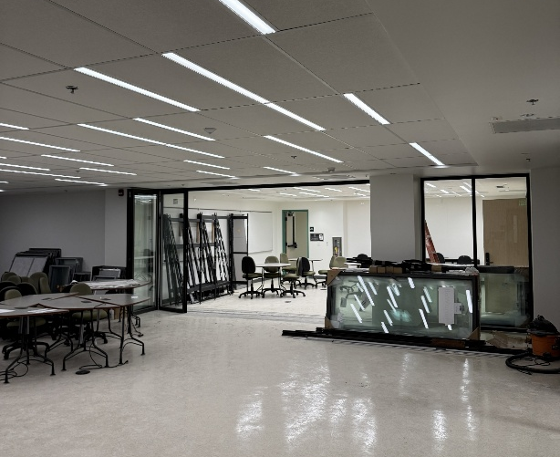
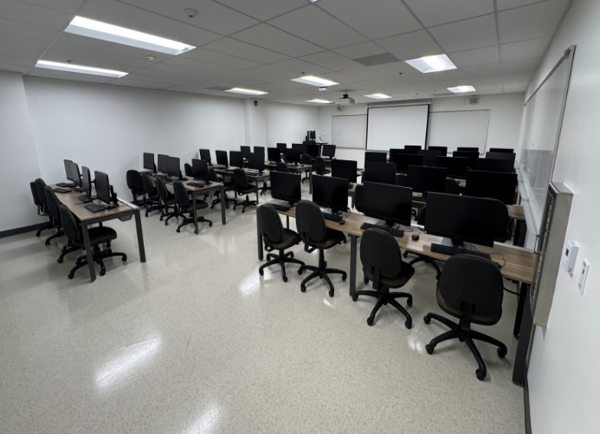
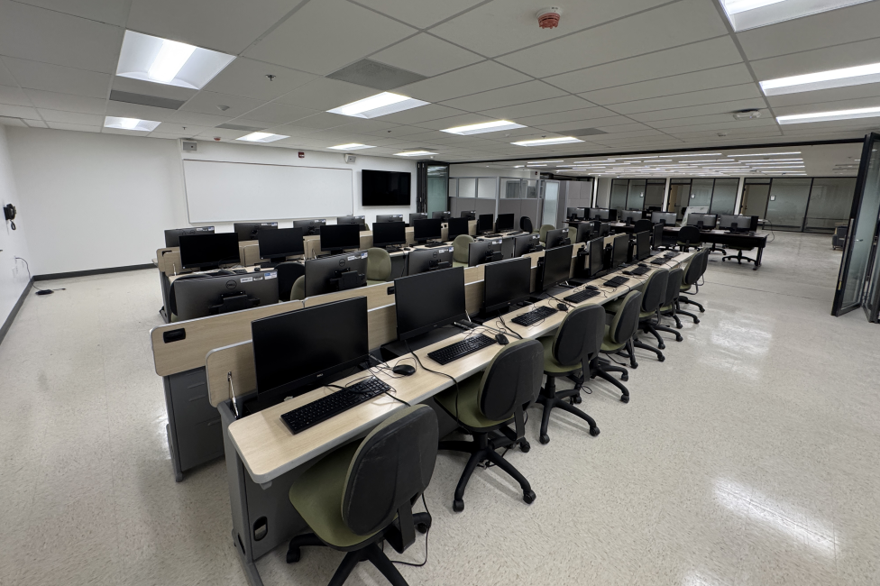
San Gabriel Renovations L2 - Math Department
Description:
Renovate 2nd floor of San Gabriel Building for Math into state-of-the-art math classrooms and labs, including Math Discovery Center
Experienced significant cost increase due to unforeseen causes, abatement issues, omitted plumbing & structural scope
  Construction Progress:
  Nov 18, 2024 Substantial Completion Date
  Jan 29, 2025 Existing Furniture Move-in
  Jan 31, 2025 Sliding Glass Partition Installation
  Feb 19, 2025 BKM Furniture Delivery
  Feb 28, 2025 Final Completion; Phased Move-in
  May 3, 2025 Space will be showcased in GCC Open House
  Project Status: Construction 100% - Pending DSA Certification
Project Budget-Total Estimated at Completion: $4.58M

Slide 7
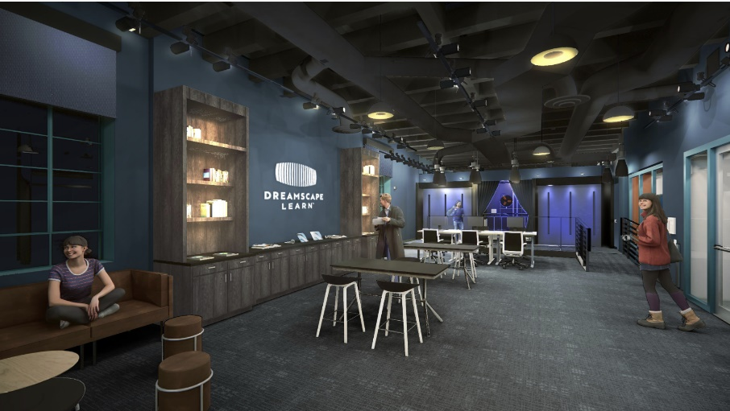
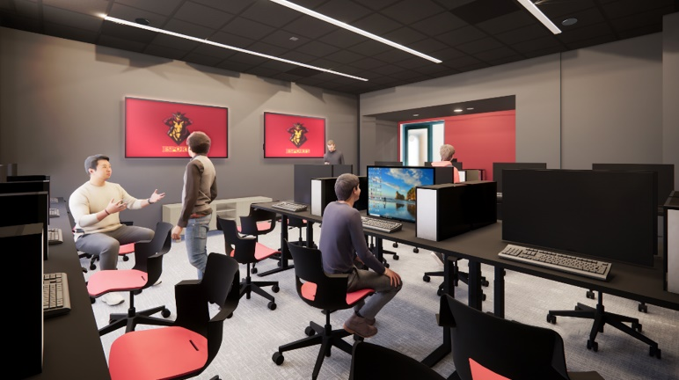
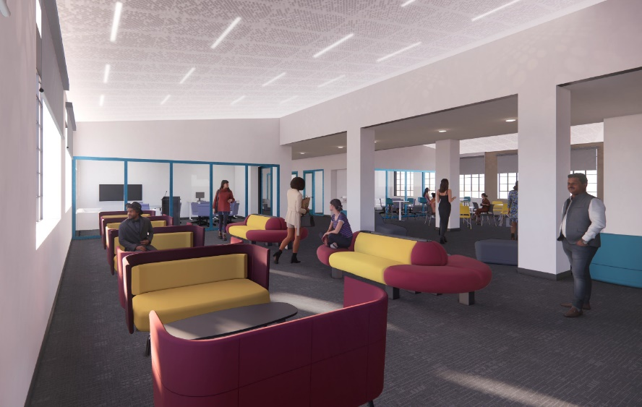
Camino Real Building Renovation
Description:
  Design began September 2023
  The Camino Real Renovation project (17,660 sf), spanning two floors in the Existing Building, will be renovated as the new home for Dreamscape Learn (DSL) Virtual Reality (VR), Makerspace, e-Gaming and Student Inclusion Spaces.
  The project team comprises of 19six Architects, Horizons Construction Co. Int'l, and Cordoba Construction Management Services.
  Schedule Update:
  Feb 27, 2025 DSA Approval
  March 18, 2025 Board of Trustees Approval for Construction
  April 14, 2025 Notice to Proceed (NTP)
  January 21, 2026 Substantial Completion is Winter 2026
Supplementary Funding:
Former Senator Anthony Portantino $4.5M for Licensing & Virtual Reality Equipment
Former Adam Schiff $1.5 M - Student Inclusion Spaces pending HUD –City of Glendale review of Form 50.4 (CEST) for release
Project Status: Construction
Project Budget-Total Estimated at Completion: $14.5M

Slide 8
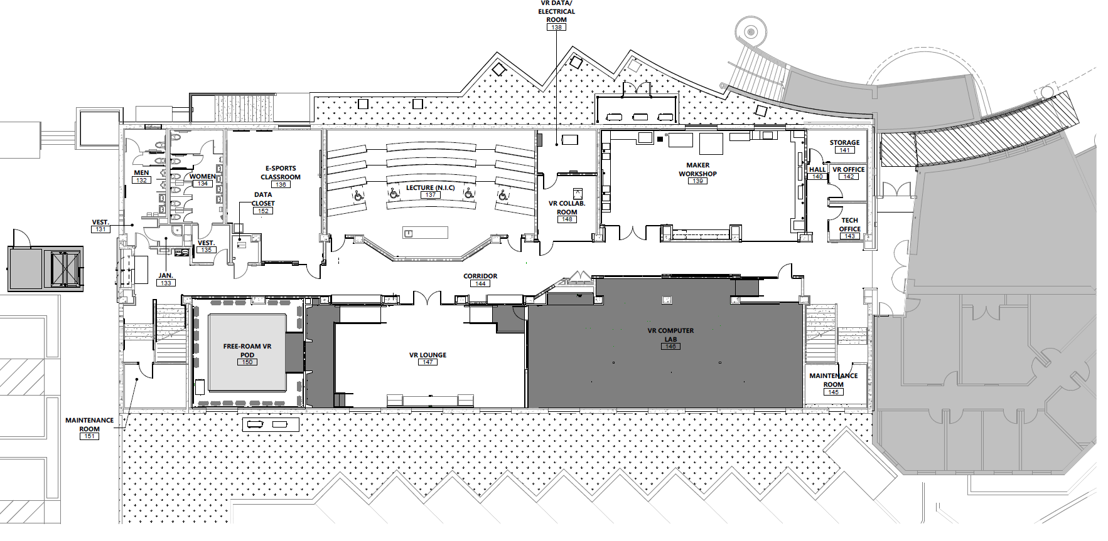
Camino Real Building Renovation
Floorplan L1

Slide 9
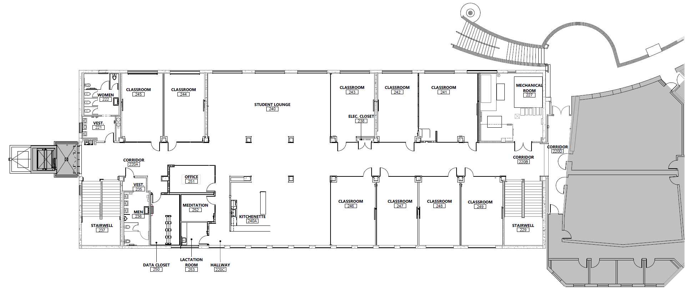
Camino Real Building Renovation
Floorplan L2

Slide 10
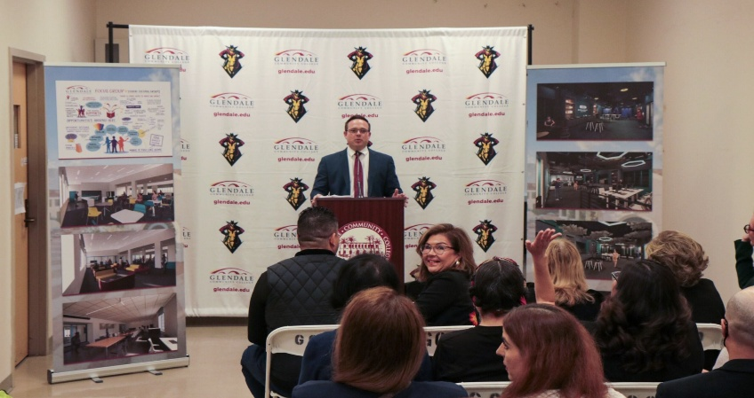
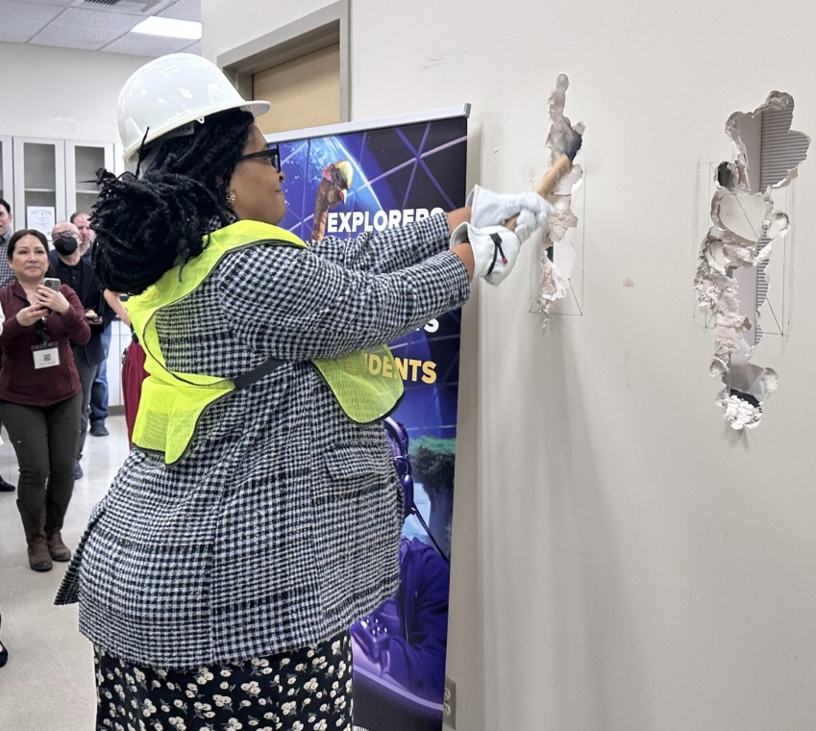
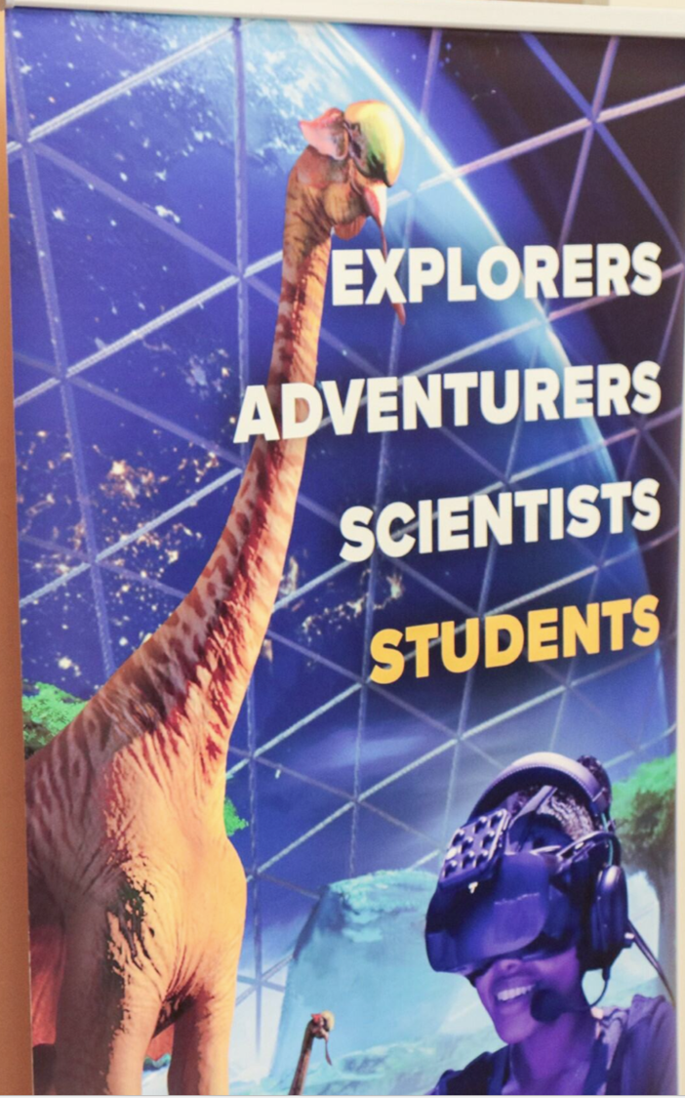
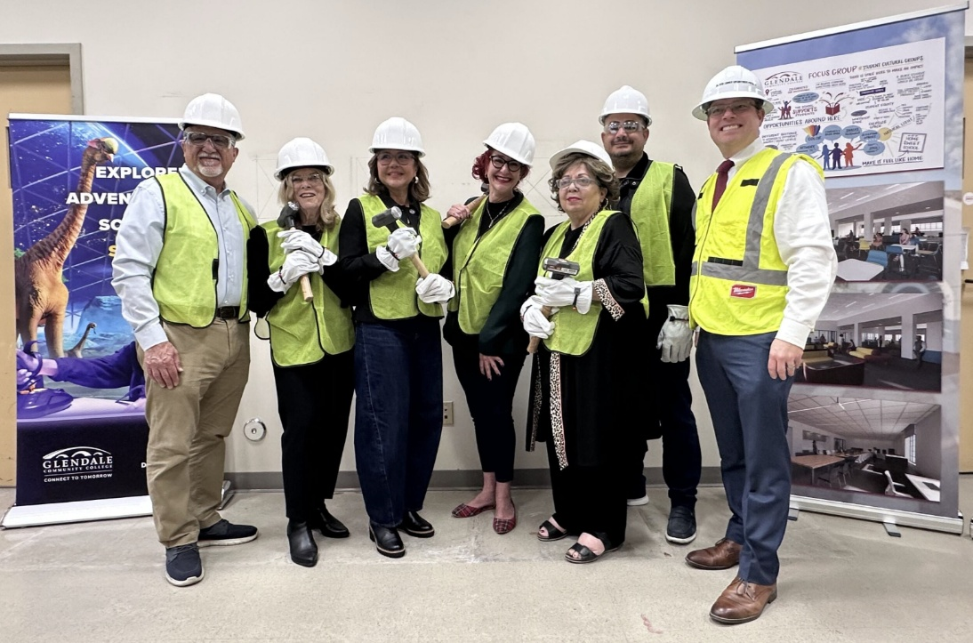
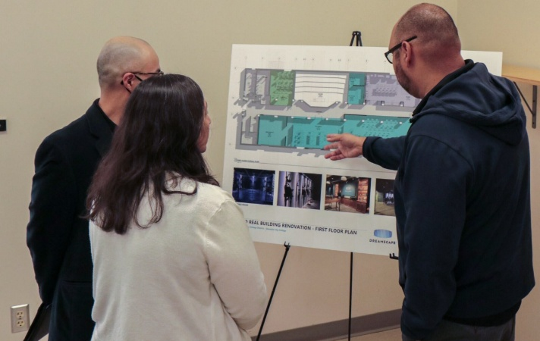
Camino Real Building Renovation
Demolition Event on Wednesday, April 23, 2025

Slide 11
For more up to date information, please visit:
https://www.glendale.edu/campusprojects
Q & A

