Slide 1

Government Relations Webinar
January 16, 2024

Slide 2

Budget Update
Assembly Committee Update
Legislative Update

Slide 3
Budget Update

Slide 4
The Governor’s Budget addresses
$37.9 billion deficit
Reserves—$13.1 billion. The budget draws upon funds from the state’s reserves.
Reductions—$8.5 billion. The budget reduces funding for various items.
Revenue/Internal Borrowing—$5.7 billion. The budget includes support from revenue sources and borrows internally from special funds.
Delays—$5.1 billion. The budget delays funding for multiple items and spreads it across the three-year period, beginning in 2025-26, without reducing the total amount of funding through this period.
Fund Shifts—$3.4 billion. The budget shifts certain expenditures from the General Fund to other funds.
Deferrals—$2.1 billion. The budget defers specific obligations to the 2025-26 fiscal year.

Slide 5


Prop 98 Guarantee
The Guarantee continues to be in a Test 1 for all years 2022-23 through 2024-25.
The funding level of the Guarantee is equal to roughly 39 percent of General Fund revenues, plus local property tax revenues.

Slide 6
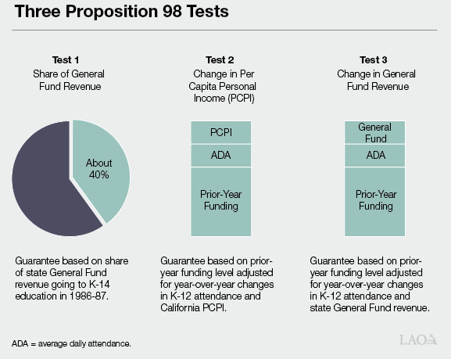

Slide 7
Proposed Withdrawal from PSSSA
Governor’s plan withdrawals:
Roughly $3 billion in 2023-24 and
$2.7 billion in 2024-25
With a remaining PSSSA balance of more than $3.8 billion at the end of 2024-25

Slide 8
University of California (UC) California State University (CSU)
Compact Deferral for UC—A one-time deferral of $227.8 million General Fund,
Compact Deferral for CSU—A one-time deferral of approximately $240.2 million General Fund
Reflects a five-percent General Fund resource adjustment pursuant to the Compact.
In 2025-26 both segments should plan for both the repayment of this one-time deferral ongoing General Fund to be included within its base budget.

Slide 9

CCC Apportionments
$69.15 cost-of-living adjustment (COLA) for Student Centered Funding Formula apportionments, at 0.76%
Consistent with K-12 COLA
$29.6 million ongoing Proposition 98 General Fund for 0.5% enrollment growth.

Slide 10
Categoricals proposed for COLA of 0.76% (in millions)
Adult Education Program
$ 4.91
Extended Opportunity Programs and Services (EOPS)
$1.40
Disabled Student Programs and Services (DPS)
$1.31
APPRENTICESHIP (Community College Districts RSI)
$.24
Calworks student services
$.42
Mandates Block Grant and reimbursement
$.94
Cooperative Agencies Resources for Education (CARE)
$.25
Childcare tax bailout
$.03
Adjustment for financial aid admin
$1.53

Slide 11



Nursing Program Support
An increase of $60 million one-time Proposition 98 General Fund to expand nursing programs and Bachelor of Science in Nursing partnerships
To develop, educate, and maintain the next generation of registered nurses through the community college system, subject to future statutory changes
Consistent with 2023-24 budget act which intended to provide $60 million one- time Proposition 98 General Fund per year for five years, starting in the 2024-25 fiscal year

Slide 12



K-14 Rainy Day Fund
To support Student Centered Funding Formula resource needs
A withdrawal of roughly $235.9 million in 2023-24
And $486.2 million in 2024-25

Slide 13



CCC Affordable Housing
Administration remains committed to a statewide lease revenue
bond approach
(Budget Summary, Higher Education, p. 30)
Developing a proposal for consideration at the May Revision
Proposes using resources included in the 2023 Budget to support those projects

Slide 14



Cal Grant Reform
The 2022 Budget Act reflected provisions regarding the fiscal conditions upon which the Cal Grant Reform Act may be implemented
The Administration remains attentive to the 2022 Budget Act’s provisions regarding the fiscal conditions upon which the Cal Grant Reform Act may be implemented
Will continue to work closely with the Legislature, the Commission, and others

Slide 15

School Facility Program
The Kindergarten through Community College Public Education Facilities Bond Act of 2016 (Proposition 51), (November 2016)
Which authorized $9 billion in state General Obligation bonds to support K-12 and community college school facilities construction.
Expects to reach agreement on a bond proposal to be considered in the November 2024 election.

Slide 16
Legislative Analyst’s Office The 2024-25 Budget:
Overview of the Governor’s Budget
Assumes $8 Billion in Lower Spending in 2022-23
Notes proposal plans to reduce General Fund spending on school and community college programs in 2022-23 by $8 billion
The budget does not specify how the state will implement this reduction
But indicates the state will make the reduction in a way that avoids impacting school and community college budgets.
Plan would make supplemental payments totaling $8 billion over a five-year period (from 2025-26 through 2029-30).

Slide 17
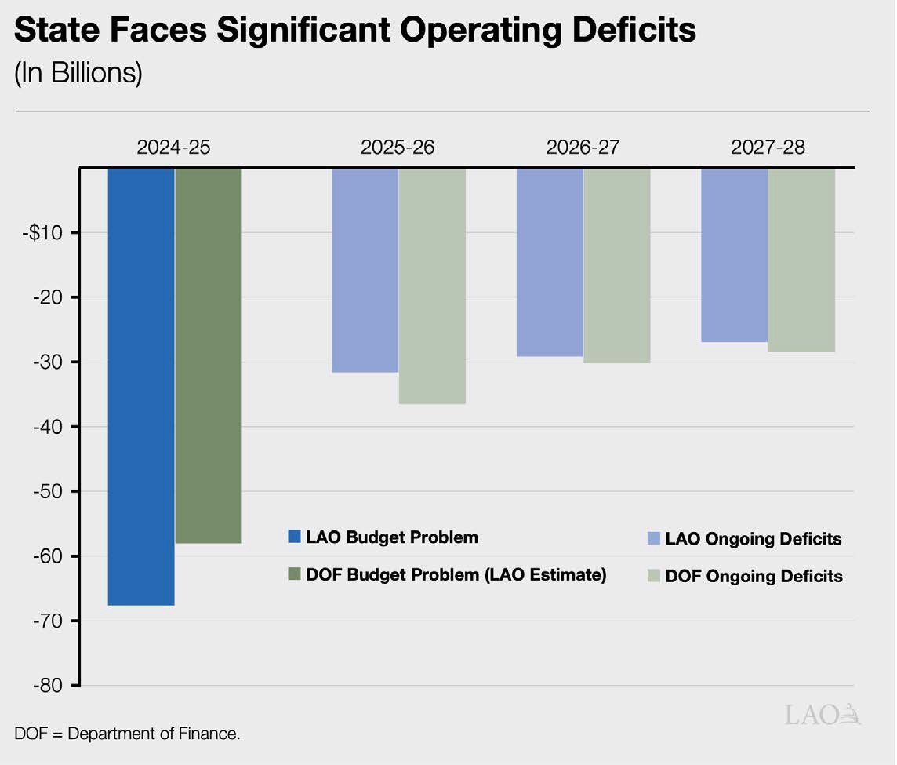

Slide 18
League Talking Points (Draft)
The Governor’s Budget prioritizes education
The Governor’s Budget affirms the value of California Community Colleges
Gratitude
Engaging your Delegation
Enrollment is up
Community Colleges are essential to workforce development
Continued investment is critical to ensure continued progress
California’s fiscal future will take time to recover
Encourage policymakers to support additional flexibility
Like 50% law, for example
Flexibility

Slide 19
League Talking Points (Draft)
Affordable Housing
Final language to be completed by May Revision
Cal Grant Reform
Decision on action to be decided in May Revision
School Facilities Bond
Funds from last bond are depleted
Bond negotiations focused on November Ballot
League supports a K-14 bond
Baccalaureate Degree Program
Our colleges can be pivotal to addressing workforce shortages
$60 million for nursing
SB 895 (Roth) on BSN authority-Ask your delegation to support

Slide 20

Overview of the Governor’s Proposed 2024-25 Budget
Budget Committee Hearings on January 23, 2024:
Assembly Budget Committee
9:30 a.m. — 1021 O Street, Room 1100
Senate Budget Committee
1:30 p.m. —1021 O Street, Room 1200

Slide 21
Assembly Committee Update

Slide 22
Assembly Higher Education Committee
Assemblymember Mike Fong, Chair Assemblymember Tri Ta, Vice Chair Assemblymember Joaquin Arambula Assemblymember Tasha Boerner Assemblymember Phillip Chen Assemblymember Bill Essayli Assemblymember Jacqui Irwin Assemblymember Corey Jackson Assemblymember Evan Low Assemblymember Al Muratsuchi Assemblymember Sharon Quirk-Silva
Alhambra
Westminster
Fresno
Encinitas
Yorba Linda
Corona
Thousand Oaks
Rolling Hills Estates
Perris
Sunnyvale
Fullerton

Slide 23


Assembly Budget Subcommittee 3
David Alvarez
San Diego
Megan Dahle
Bieber
Bill Essayli
Corona
Mike Fong
Alhambra
Kevin McCarty
Sacramento
Al Muratsuchi
Rolling Hills Estates

Slide 24
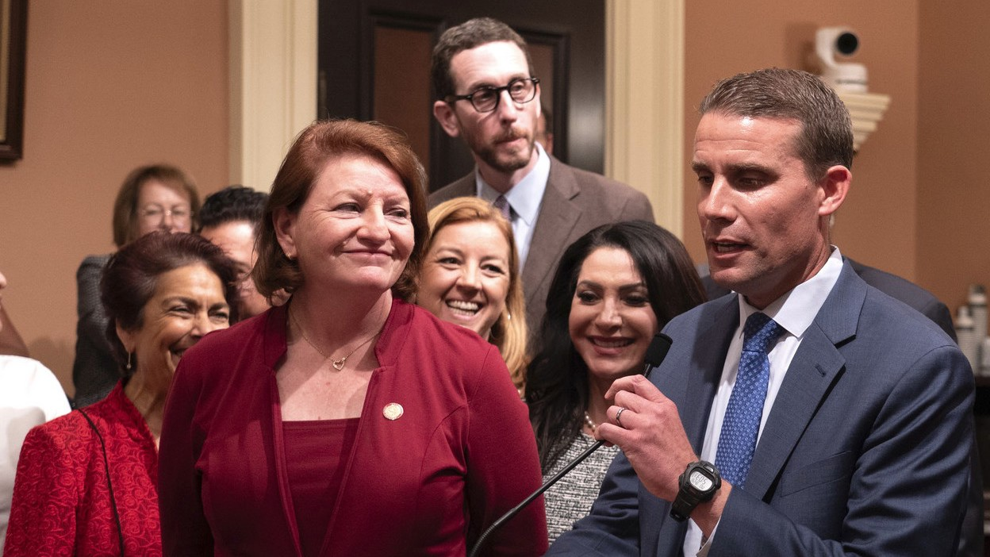



Senate Leadership Change
Monday, February 5th

Slide 25
Legislative Update: 2-Year Bills

Slide 26
AB 359 (Holden) Dual Enrollment
AB 359 (Holden) Dual Enrollment: College and Career Access Pathways partnerships
Among other provisions, would authorize a community college district to enter into a CCAP partnership outside of their service area if a local college district has denied a request to establish a CCAP partnership. Removes the requirement for a high school principal to individually recommend students to participate in dual enrollment courses. Allows courses to be offered in a synchronous or asynchronous online format.
Location: Assembly Appropriations Committee

Slide 27
AB 810 (Friedman) Hiring Practices
AB 810 (Friedman) Hiring Practices: academic, athletic, and administrative appointments.
Requires an applicant for employment who has reached the final stage of hiring to disclose any previous employment findings of misconduct against them.
“Misconduct” means any violation of the policies governing employee conduct at the applicant’s previous place of employment, including, but not limited to, violations of policies prohibiting sexual harassment, sexual assault, or other forms of harassment or discrimination, as defined by the employer.
Applies to the hiring process for an appointment to an academic, or athletic, or administrative position
Location: Assembly Appropriations Committee

Slide 28
AB 1142 (M. Fong) CPEC
AB 1142 (M. Fong) Postsecondary Education: Coordinating Commission for Postsecondary Education in California
Would create the Coordinating Commission for Postsecondary Education in California as the statewide postsecondary education oversight, coordination, and planning agency. The Commission would be an independent state agency, which shall be advisory to the Governor, the Legislature, other appropriate government officials, and institutions of postsecondary education.
All other details were removed from the bill, and an informational hearing is planned in the coming months
Location: Assembly Appropriations Committee

Slide 29
AB 1575 (Irwin) Confidential Advocates
AB 1575 (Irwin) Public postsecondary education: sexual harassment, sexual violence, and discrimination: disciplinary actions: confidential advocates and advisors
To be eligible to receive state financial aid, an institution of the California Community Colleges (CCC), the California State University (CSU), and the University of California (UC), must adopt a policy permitting a student to be represented by an advisor if the student receives a notification of a disciplinary action. The advisor may be a confidential advocate.
Each institution shall employ at least two confidential advocates to assist in its response to discrimination.
An institution is not required to employ a confidential advocate if it enters into a memorandum of understanding with a local victim advocacy organization to provide confidential advocates on campus.
Location: Assembly Appropriations Committee

Slide 30
AB 1160 (Pacheco) Debt Collection
AB 1160 (Pacheco) Protecting Students from Creditor Colleges Act
Prohibits an institution from placing an enrollment or registration hold on a current or former student’s account or refusing to provide a transcript or diploma on the grounds that the student owes an institutional debt. Requires institutions to wait 180 days after alerting students of their debt before engaging with third-party debt collectors.
Prohibits institutions from dropping students for unpaid fees/tuition until the “drop for non-payment” deadline.
Location: Assembly Appropriations Committee

Slide 31
Legislative Update: Newly Introduced Bills

Slide 32
Newly Introduced Legislation
AB 1780 (Ting) Postsecondary Education: legacy admissions
States the intent of the author to introduce legislation related to legacy admissions in institutes of higher Education.
SB 906 (Skinner) Student Athlete Bill of Rights
States the intent of the author to further modify existing law related to the student athlete's bill of rights.
AB 1790 (Connolly) California State University: sexual harassment: implementing California State Auditor recommendations
Requires the California State University to implement the recommendations provided in a specified California State Auditor report by January 1, 2026.

Slide 33
Newly Introduced Legislation
AB 1818 (Jackson) Homeless students: parking
Requires each CCC, CSU, and UC campus to allow overnight parking by a student attending its campus if:
The student uses the vehicle as housing.
The student has a valid parking permit issued by the campus.
The vehicle is parked in or on a campus-owned and controlled parking lot or parking structure.
Prohibits each campus from citing or penalizing a student if:
The student has a valid parking permit issued by the campus, and
The vehicle is parked in or on a campus-owned and controlled parking lot or parking structure.

Slide 34
Newly Introduced Legislation
SB 895 (Roth) Baccalaureate Degree in Nursing Pilot Program
Authorizes Baccalaureate Degree in Nursing (BSN) programs at 15 community college districts, selected by the Community College Chancellor. The programs must have equitable access throughout the northern, central, and southern parts of the state, and priority must be given to districts in underserved nursing areas. This authority would sunset in January 2031.

Slide 35


January 28-29, 2024
Annual Legislative Conference
Sheraton Grand Sacramento
THEME
Advancing our Collective Voice:
Effective Advocacy for Equity and Success

Slide 36



Save the date:
BASIC NEEDS CAPITOL BRIEFING
Tuesday January 30th, 2024 10:00 am
Legislative Office Building, Room 100 1020 N Street
Sacramento, 95814

Slide 37

Tuesday, February 6
7:30 – 9:00 a.m.
$75/person
Marriott Marquis Washington, D.C.

Slide 38



Slide 39
Thank you!

