Slide 1

Guide to Reopening 2021- 2022
Glendale Community College
Child Development Center

Slide 2
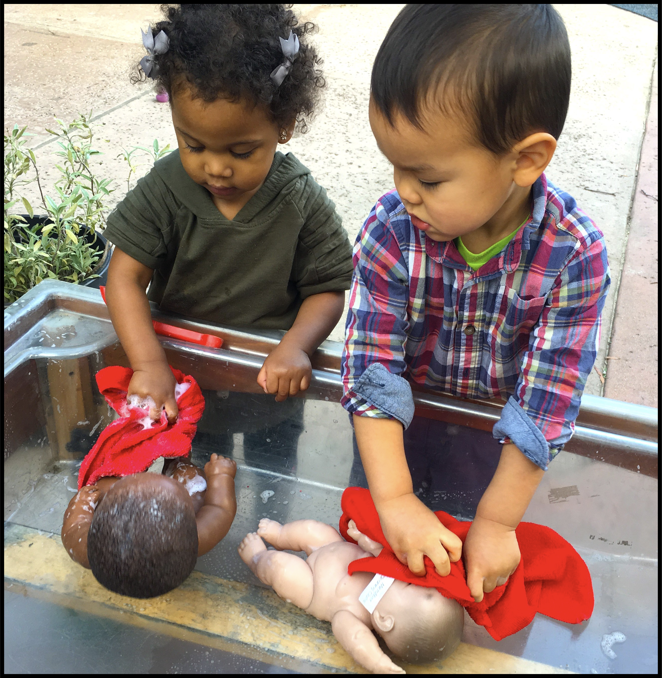
The following Guide to Reopening describes our plans to reopen GCC Child Development Center, in accordance with state and local public health department requirements for children and staff safety.
This Guide reflects the current science-based understanding about COVID-19 and be mindful that priorities and practices will change as the science-based facts change.
We hope the Guide provides clarity and confidence, as it reflects the work of our task force, administrators, and medical doctors/nurses who are also current GCC parents. Beginning with the expectation that every family will embrace our commitment to safety, each section of the Guide maintains our highest priority: the health of our children and staff. Because of the fluid circumstances typical to a pandemic, we will continue to review our plans and communicate the necessary adjustments to ensure it complies with state and local public health department guidelines and science- based recommendations to ensure children and staff safety.

Slide 3
Contents
Our Commitment to Safety
Face Masks
Arrival/Dismissal
Daily Screening Procedure
Classroom Space
Schedule
Meals
Community
COVID-19
Non-Essential Visitors
Reminders
Hygiene & Disinfecting

Slide 5

Our commitment to safety
Glendale Child Development center defines itself as a safe and inclusive community. All members of the community —parents, children, staff—are accountable for following safety protocols.
Community members who knowingly do not cooperate with the centers expectations for safety will not be allowed on campus.
This document is for the sole purpose of providing guidance. No legal, medical, or professional advice or opinions are given herein or may be relied upon. Each family should consult with their own physician when considering the risks involved with a return to in-person instruction.

Slide 6

Face Masks
Properly worn face masks and physical distancing are widely accepted as effective barriers to germ spread.
For reasons of safety and hygiene, we will be providing clean face masks for daily use. Children will be handed with a new mask twice a day; one every morning at sign in and again after nap time. Also, mask will be provided to the children throughout the day as needed. We recognize the numerous challenges posed by face masks for our youngest children.
All children must wear face masks when on campus, except while eating, napping and during designated outdoor space. “Mask breaks” will be provided as needed when children are physically distanced and or playing in their individual space.

Slide 7

Hygiene & Disinfecting
The center established personal hygiene expectations are that all children and staff will wash their hands and sanitize regularly, especially when entering the classroom in the mornings, before/after eating, after outside time, after using the restroom, and after coughing into one’s hands or blowing one’s nose. We have added indoor/outdoor handwashing stations throughout campus to enable additional supervised hand washing for children.
Throughout the day, all surfaces will be wiped down with disinfectant (examples: playground equipment, doorknobs, tables, etc.). At the end of the day, all class spaces will be disinfected with eClorox 360 electrostatic sprayer in preparation for the following school day.
Staff will take full advantage of our outdoor space for instruction, mealtimes, and downtime for children.
All HVAC filters will be replaced with MERV-13 rated filters for enhanced air filtering and have NPBI technology system that safely cleans all indoor learning spaces.

Slide 8



Arrival & Dismissal
Morning Drop-off
Arrival and drop off-times will be staggered as consistently as practicable. To ensure safety and social distancing parents/caregiver will be reminded that all visits should be as brief as possible and to wear mask. Upon arrival children will go thought the daily health screening process and have their hands wash. The child will then be handed with a new disposable face mask before the teacher walks the child to their assigned classroom.
Afternoon Pick-up
Classroom teacher will receive notification of the parent’s arrival. The teacher will walk the child to the front gate.
When possible, the same parent/caregiver should drop off and pick up their child every day (to avoid designating those who are at high risk). Parents will need to call/email and notify the office ahead if picking-up/drop-off person has changed. Photo ID will be required of the person who will be picking-up/dropping-off the child. Staff will escort the child for arrival and departure.

Slide 9


Daily Screening
Daily Health Screening will take place every day before entry for COVID-19 symptoms. The site will follow DPH guidance on Decision Pathways for persons who screen positive for symptoms before entry to the center.
Temperatures of all children will be taken upon arrival each day. Use OSHA PPE guidelines for temperature checks. Temperatures will be logged daily. If symptoms are present, the child will not be allowed to enter the center. The parent/guardian will be expected take the child to a physician for further evaluation and return to school with physician verification.
Children will be monitored throughout the day for possible signs of illness.
Staff will document/track incidents of possible exposure and notify local health officials, staff, and families immediately of any possible cases of COVID-19 while maintaining confidentiality as required by the Americans with Disabilities Act (ADA).

Slide 10
Classroom Space
Classroom groups will not mix in classrooms, outdoor spaces, or any common space within the facility, so no 2 groups are in the same place at the same time.
Staff will ensure the same children remain in the same group each day.
  There will be a maximum of 11 children in the preschool classroom and 9 children in the toddler classroom. Each child will stay in the same group throughout the day.
Children will use the same rest cot daily. Each cot will have the child’s name on it.
  Center will provide a sheet for each child’s cot.
  A child may bring a comfort item for rest time only. The comfort item will be stored in child’s cubby to minimize the spread of the virus, the comfort item will be kept at the center and only be returned at the end of the school year.
  All bedding and comfort items will be washed daily at the center.
  Children will be placed head to toe and 6 feet apart from one another for nap time.
As many activities involving children as possible are conducted outdoors.

Slide 11

Meals
Children will practice proper hand-washing before and after eating.
Staff will wear gloves while serving food and wear masking during mealtimes.
Meals will be served outside.
Children will have a designated eating area to ensure social distancing. Staff will rearrange the eating area to create distance between children as far apart as possible and children will sit in their assigned seats for every meal.
Meals will be catered by Head Start and meals will be served in a modified family-style.
Tables and trays will immediately be cleaned and disinfected after meals.
Staffs will not eat with the children during mealtimes. All staffs will have meals separately from the children at their scheduled lunch time.
Teachers will engage in with children in back-and-forth conversation during mealtimes.

Slide 12

Schedule
Social distancing strategies will be implemented at all times. The same children will remain in the same group each day, no surrounding care will be provided.
Teachers will be assigned to the same class group.
Staff will alternate, stagger or shift work schedules, when possible, to maximize physical distancing.
Final schedules to be determined
Hours of Operation: 8:00am – 5:00pm
Staff Schedules: 7:00am - 3:30pm and 9:30am – 6:00pm

Slide 13
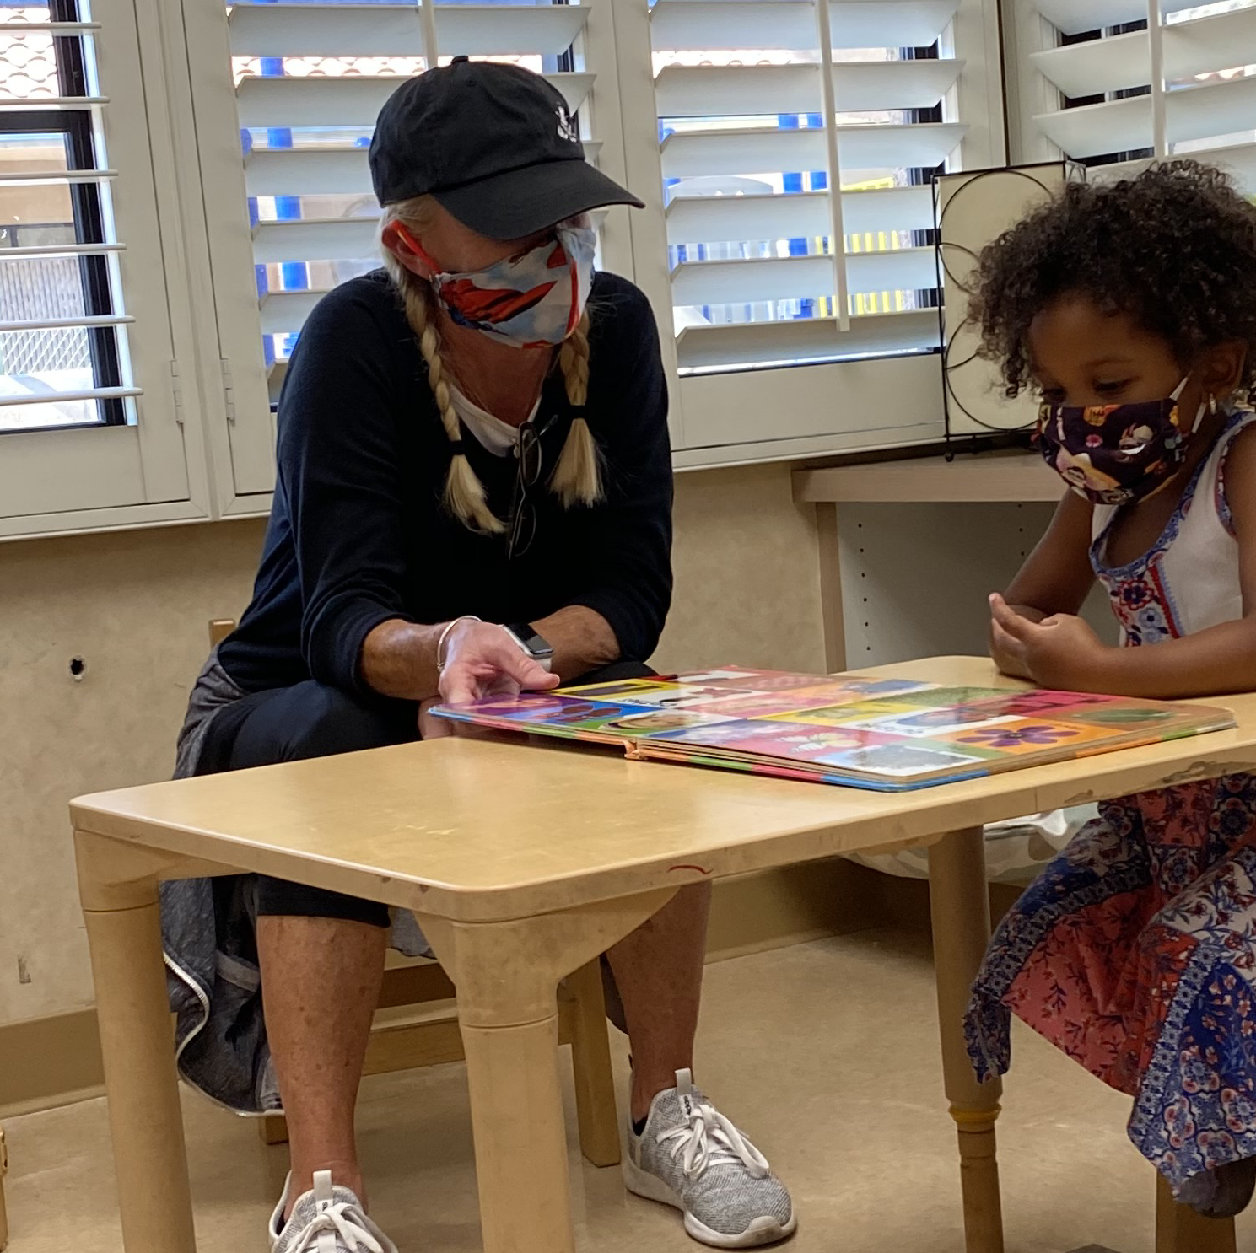
Community
On-campus community events for the fall will have to be postponed, cancelled, or re-imagined to ensure the safety of our families and staff. We will continue to stay in touch as we have more information about our on-campus events.
Here are some examples of events we are working on:
Meet and Greet - We will be doing this event by appointment on August 30th. Sign-ups will be emailed so that each family has an opportunity to meet their teacher and see their classroom prior to starting school on September 7th.
  Class meet-ups (to be held virtually - details to follow)
  Family Tour (to be held in-person by appointment)
  Classroom Connection (to be held virtually - details to follow)
  Parent Conferences (to be held virtually by appointment)

Slide 14
College Students
College Student:
All College students will need to be vaccinated before entering the center.
  Student lessons will be held outdoors and supervised by our teachers.
College student practicum hours will be determined.
  Information will be provided as they are available.
  Lab student schedules will be posted on Learning Genie when available.
  Students will continue to complete the required observation through our updated camera system.

Slide 15

Covid-19 Virus
Symptoms of Possible COVID-19 Infection:
Fever or chills
Cough
Shortness of breath or difficulty
breathing Fatigue
Muscle or body aches
Headache
New loss of taste or smell
Sore throat
Congestion or runny nose
Nausea or vomiting
Diarrhea

Slide 16

Symptom response
Criteria for Returning to School
What Happens If…
At School
If a child or staff displays signs or symptoms of possible COVID-19 infection, they will be moved to an isolation room. Children will be safely supervised until their parent/guardian can pick them up from school. Child and staff should see a physician and be evaluated for COVID-19 in these circumstances.
The School will report one or more cases of COVID-19 to the Los Angeles County Department of Public Health (DPH) officials, Community Care Licensing Division (CCLD) staff, and families of any confirmed case of COVID-19.
Before returning to school, child and staff will be required to meet the criteria listed to the right.
IF a negative test result for COVID-19 is obtained OR a non-contagious and non- respiratory source of infection is verified by a physician, THEN a child or staff may return to school if all the following criteria are met:
CHILD AND STAFF STAYS HOME UNTIL FEVER FREE (lower than 100°F) WITHOUT FEVER REDUCING MEDICATION FOR 24 HOURS AND IMPROVED SYMPTOMS.
WRITTEN VERIFICATION BY A PHYSICIAN OF *NON-CONTAGIOUS AND NON-RESPIRATORY SOURCE OF INFECTION
IF a positive test result for COVID-19 is obtained OR no test is obtained, THEN child or staff may return to school if all the following criteria are met:
CHILD AND STAFF STAYS ISOLATED AT HOME UNTIL FEVER FREE (lower than 100°F) FOR 24 HOURS, IMPROVED SYMPTOMS, AND 10 DAY FROM SYMPTOM ONSET.
NO MEDICATION TAKEN TO REDUCE FEVER OR PAIN IMPROVING SYMPTOMS
WRITTEN VERIFICATION BY A PHYSICIAN THAT THE ABOVE CRITERIA HAVE BEEN MET.
*Non contagious= Are noncommunicable illness. This does NOT include flu, common cold, norovirus (“Stomach Flu”), and etc.

Slide 17

Exposure response
Criteria for Returning to School
What Happens If…
Exposure at:
Center, At home or Outside
When a child or staff is exposed to a known COVID-19 person when not wearing a mask or with significant time of exposure, they will be expected to…
  Must self-quarantine for 10 days from the last contact even if the child does not show symptoms.
  Staff who have been fully vaccinated does not have to self-quarantine. But must provide physician verification.
If a child or staff is unable to isolate from a COVID-19 positive family member, they must isolate away from school for 10 - 14 days from the last day of the family members offset.
Before returning to school the child or staff must provide a PHYSICIAN VERIFICATION and/or NEGATIVE COVID TEST RESULT.
IF a negative test result for COVID-19 is obtained OR a non-contagious and non- respiratory source of infection is verified by a physician, THEN a child or staff may return to school if all the following criteria are met:
10 DAYS AFTER SELF-QUARANTINE CHILD MUST BE FEVER-FREE (lower than 100°F) FOR 24 HOURS
NO MEDICATION TAKEN TO REDUCE FEVER OR PAIN
IF a positive test result for COVID-19 is obtained OR no test is obtained, THEN child or staff may return to school if all the following criteria are met:
10 DAYS AFTER SYMPTOM ONSET (not test date) FEVER-FREE (lower than 100°F) FOR 24 HOURS
NO MEDICATION TAKEN TO REDUCE FEVER OR PAIN IMPROVING SYMPTOMS
WRITTEN VERIFICATION BY A PHYSICIAN THAT THE ABOVE CRITERIA HAVE BEEN MET.

Slide 18


Symptom response
Cohort notification
Communication is crucial
In compliance with our community guidelines, parents or employees must notify the school immediately if exposure to COVID-19 outside of school has occurred.
If a child and or staff leaves school with possible signs or symptoms of COVID-19 infection, or if the school is notified that a child has been exposed outside of school, the cohort will be contacted of a potential exposure.
Parents/guardians WITHIN THE COHORT will be asked to monitor children and their siblings for signs or symptoms.
Children in cohort will continue attending school with attention to mask wearing, distancing, and hand-washing/sanitizing.
If the child or staff obtains a positive COVID-19 test, we will notify ALL SCHOOL families and expect families to monitor their students for signs or symptoms.

Slide 19
Non-essential visitors
Visitors and persons non-essential to the operation, that they may not enter the premises. The number of people in the facility will be limited to the number appropriate for maintaining physical distancing. Only CDC staff and children will be able to enter.

Slide 20

Reminders
QUESTIONS
Call our office at (818) 240-1000 *5665 or email Jeanette Tashiro at Jtashiro@glendale.edu or the front desk at cdc@glendale.edu
We take safety very seriously and are prepared to keep your child safe and engaged in their learning. If you have any questions or concerns, please don't hesitate to contact us!
Contact Classroom Teachers Here :
Koala Classroom: koalacdc@glendale.edu
Dinosaur Classroom: dinocdc@glendale.edu
Cricket Classroom: cricketcdc@glendale.edu
Dragon Classroom: dragoncdc@glendale.edu

