Slide 1
Affective Domain

Slide 2
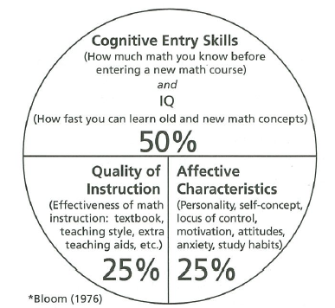
Variables Contributing to Student Achievement.

Slide 3
Think of topics that interest you and find an intersection with affective domain.
Personal Growth
Motivation
Inspiration
Success
Leadership
Team Building
Sports

Slide 4


Slide 5



Slide 6


Slide 7
Soft Skills versus Hard Skills
Attitude
Motivation
Goal setting
Positive affirmations
Managing anxiety
Self confidence
Leadership
Study Skills
Reading the Textbook
Note taking
Test preparation
Test taking
Learning from your mistakes
Time management

Slide 8
Resources
Math Study Skills Workbook 5th ed. by Dr. Paul Nolting
Becoming a Master Student 16th ed. by David Ellis
On Course; Strategies for Creating Success in College and Life
9th ed. by Dr. Skip Downing

