Slide 1
Adderall
The Catch 22 of Adderall’s therapeutic use and abuse.
Presented by
Zoila Navales, RN

Slide 2
What’s the plan?
Intro / Terminology
Public Perception of Adderall
Brief History
Popularity
Risks, benefits, and consequences
Open Discussion

Slide 3
Scheduling
Drugs, substances, and certain chemicals used to make drugs are classified into five (5) distinct categories or schedules depending upon the drug’s acceptable medical use and the drug’s abuse or dependency potential.
The abuse rate is a determinate factor in the scheduling of the drug
Rating is from Schedule 1 (most) to 5 (least)

Slide 4
Guessing Game:
  Name which schedule category each drug should be under:
  Tramadol, Xanax
  Robitussin
  Heroin
  Codeine
  Vicodin

Slide 5
Answers:
1: Heroin
2: Vicodin
3: Codeine
4: Tramadol, Xanax
5: Robitussin

Slide 6
Guess which category Adderall is in?

Slide 7
Schedule 2 Drugs: high potential for abuse which may lead to severe psychological or physical dependence.
Examples:
  Hydromorphone (Dilaudid)
  Methadone (Dolophine)
  Meperidine (Demerol)
  Oxycodone (OxyContin, Percocet)
  Fentanyl (Sublimaze, Duragesic)
Dexedrine, Adderall, and Ritalin
What do they have in common?
  Potential for abuse
  Accessibility

Slide 8
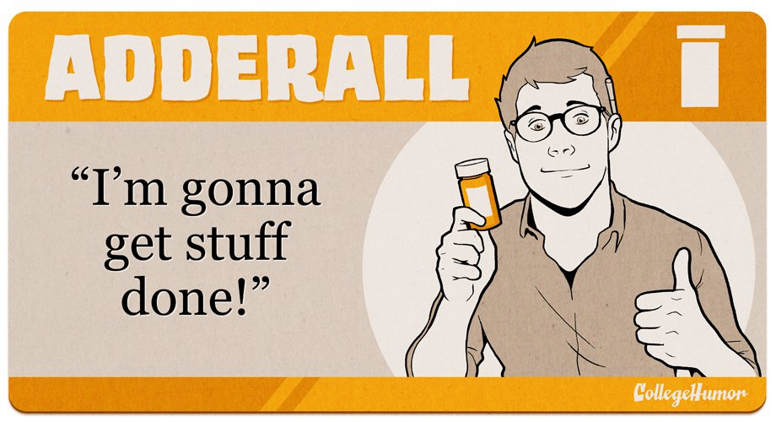
Adderall…Add for all???

Slide 9


Slide 10
Uses for Adderall
Therapeutic:
  Stimulant used to focus for ADHD
  Asthmatics
  Cold medicine
  Narcolepsy
Recreational:
  Study Buddy/”Academic Steroid”
  Weight loss
  Energy and focus
Dependency/Addiction:
  Highly addictive
  Unable to function/focus without it
  Easy to build tolerance, which is an early sign of addiction

Slide 11
Feeling Euphoric and Focused
Benzeprine
Cold & Asthma
20’s/30’s
“War & Drugs”
30/40’s
“Happy Wife, Happy Life”
60’S
Too Much Party
ADHD
90’s/2000’S
Amphetamines… I think I got something
-Romanian Chemist, Lazăr Edeleanu in 1887
Adderall
This Feels Amazing!
Gordon Alles, 1929

Slide 12
Let’s talk terms
Therapuetic Use: Uses of chemicals which affect the course of conditions, diseases, syndromes or pathology to benefit the health of an individual.
Tolerance: which means needing more of the drug to obtain the same result. Often, as use increases, it becomes impossible to ever recreate the initial high.
Dependency: which means that after some time your body will function sub-optimally without the drug present in your system.
Addiction: which means that compulsive drug seeking behavior and persistent drug use continue despite full knowledge of the risks and negative life consequences that have developed.

Slide 13
Addiction
Addiction implies an intense desire for something, loss of control of its use, and continuing to use it in spite of the negative consequences it implies. Addiction changes brain structure and modifies how the brain registers pleasure.

Slide 14
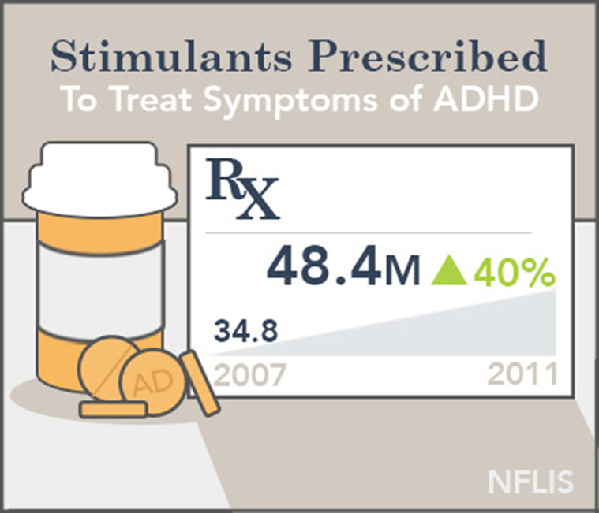
Epidemic in Schools
Before drugs was an escape from school, now it’s used to succeed in school
ADD was first introduced in DSM in 1987, exclusively in kids.
Mainly 18-to-25-year-olds who are inappropriately taking Adderall without a prescription.
Mid 2000’s, adults between 20-39 is the fastest growing group receiving drug

Slide 15
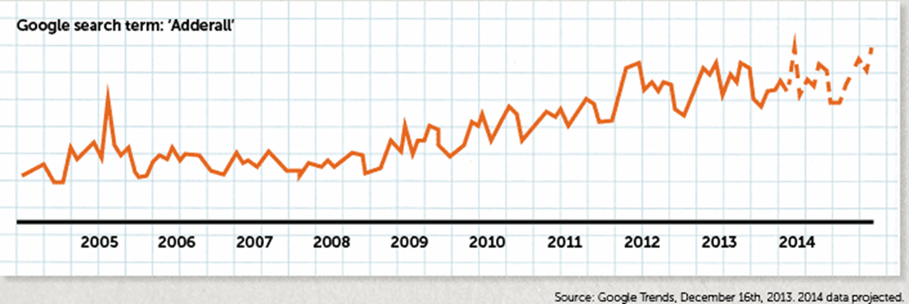
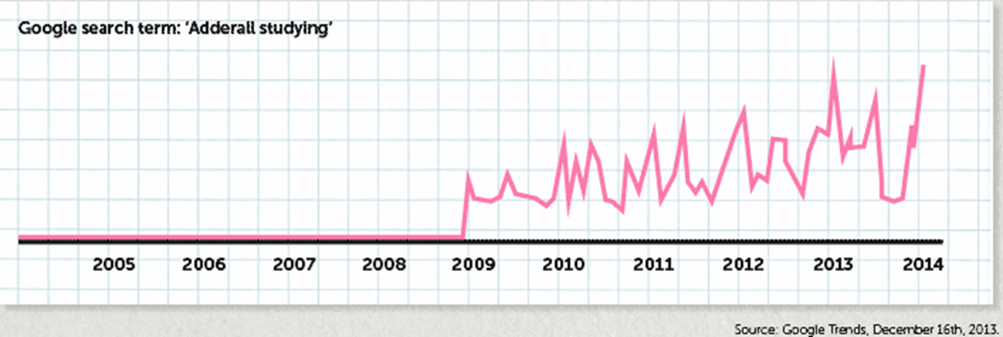

Slide 16
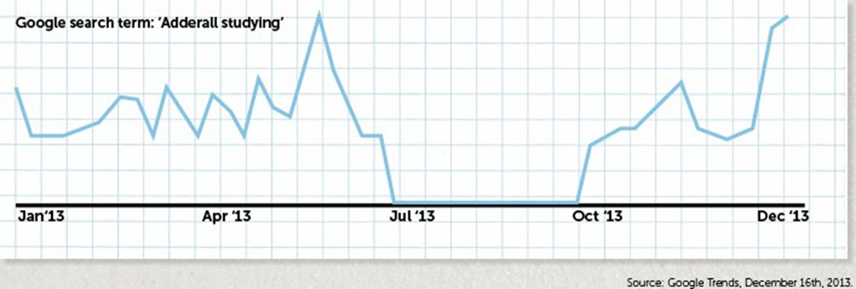
What do you notice?

Slide 17
Amber’s Story
Amber knew before she even started college that she wanted to be a doctor, and she was working hard in her pre-med classes at Santa Clara University. But…
“That night, I took it for the first time to study for exams, and man, I remember feeling like I’ve never felt before,” says Amber, now 21…
So from then on, I would take it only on occasions where I really needed to study for exams.”
At first, Amber was swallowing one 20-mg pill, once every week or two…It didn’t take long for her to feel like she needed the drug — and not just to study.
“Next thing you know, I’m literally popping up to 120 mg in a day to chase that Adderall high that I love more than anything, even more than myself. I now have to take high doses every day just to feel normal.”
“Yet I can’t stop. I don’t care to stop. And I don’t want to stop.”
-Huffington Post, “The United States of Adderall”

Slide 18
Why?
Hyper-glamorized?
  Social Media, Songs, etc.
  Movies like Limitless
Normalcy/Not typical addict look?
  Dealer looks like me? Shows create normalcy (Roseanne)
  If coke or meth produced the same outcome, but with physical signs of abuse, will you still be ok with it?
Money
  $5-20/pill with Inflation
  Alternative for people without insurance
Academic Steroid/Enhancer
  Belief that it increases competitive production, but at what cost?
  Quick fix, not willing to put in the time to allow our bodies to react and adjust, instead we manually take control to force the desired result.

Slide 19
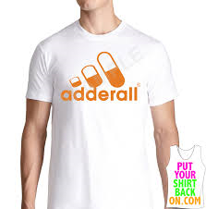
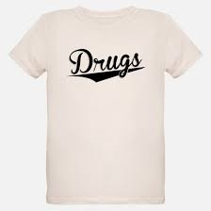

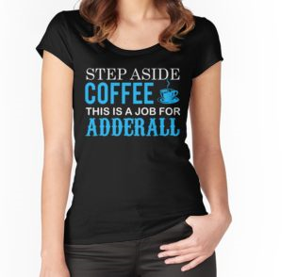
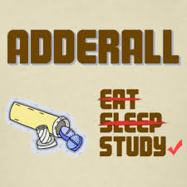

Slide 20
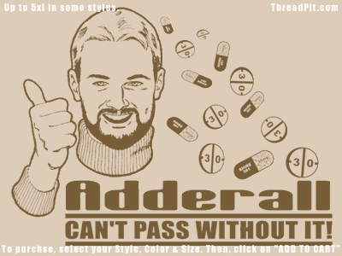
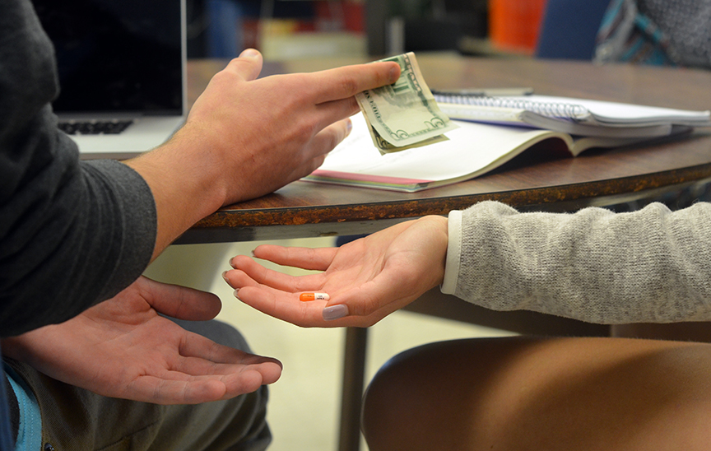
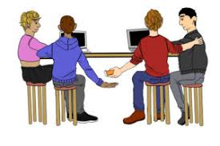
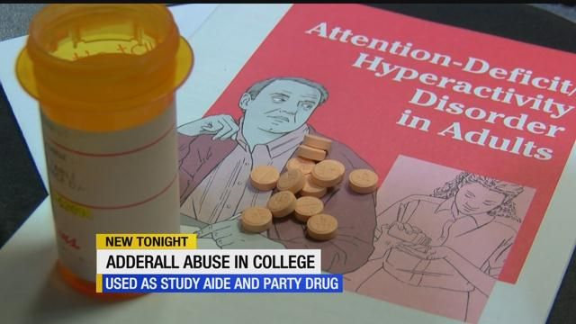
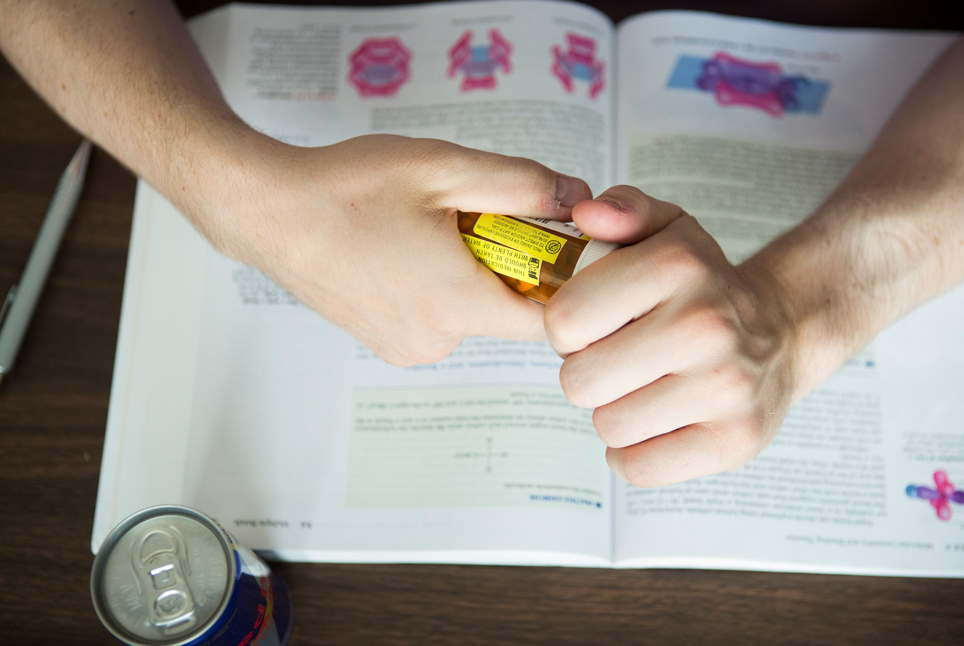

Slide 21
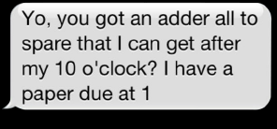
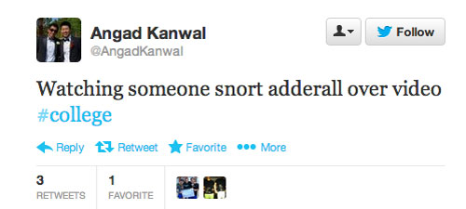
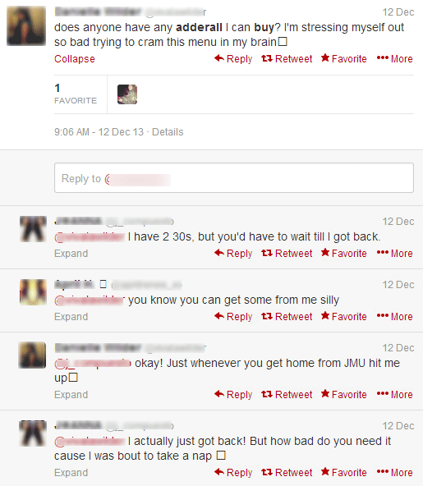
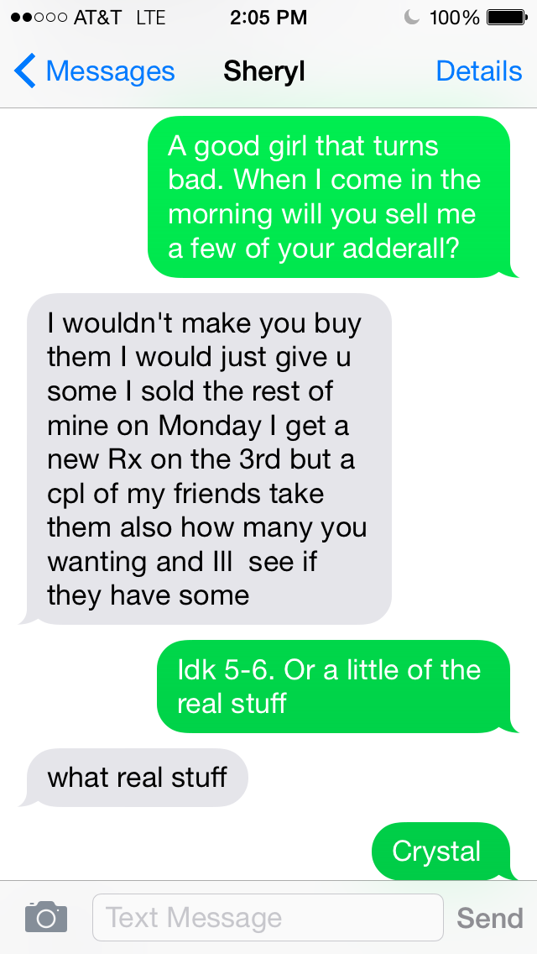

Slide 22
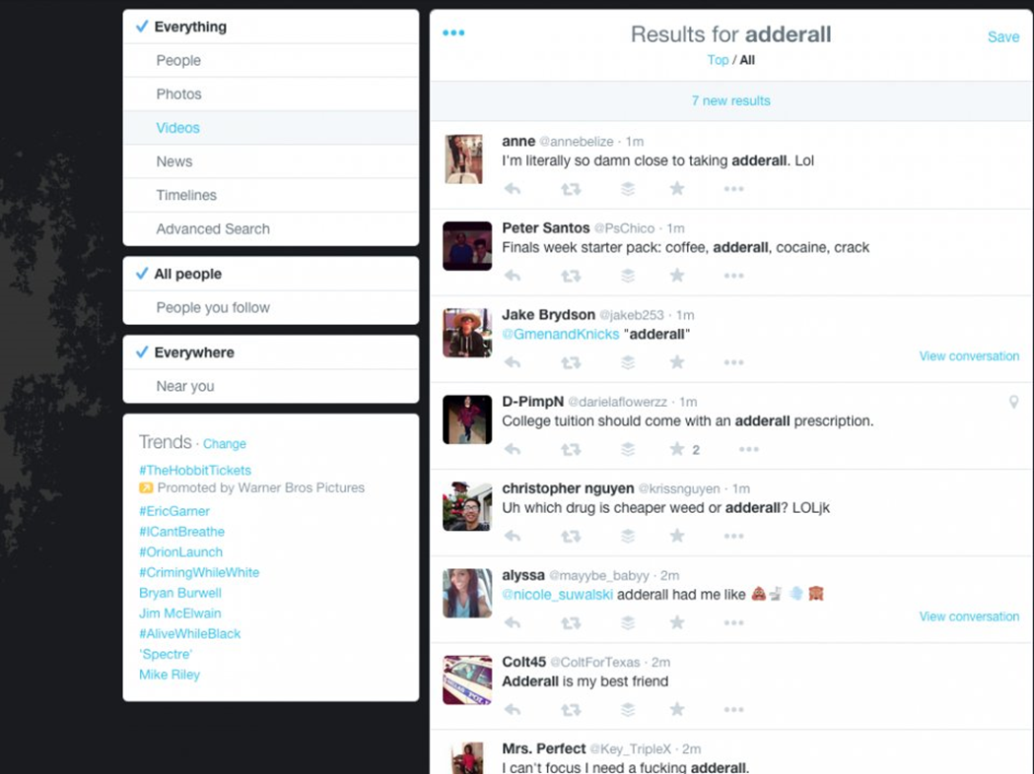

Slide 23
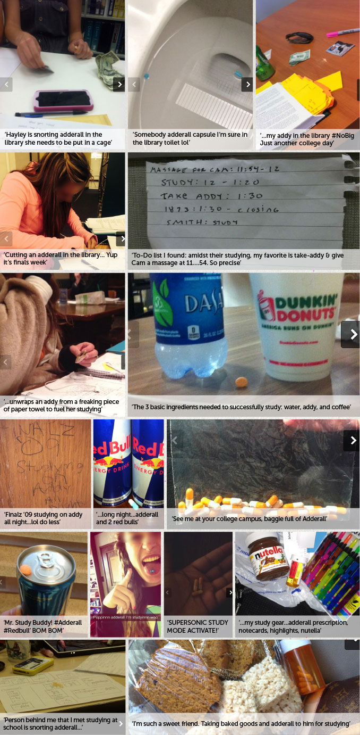

Slide 24
Who is dealing?

Slide 25
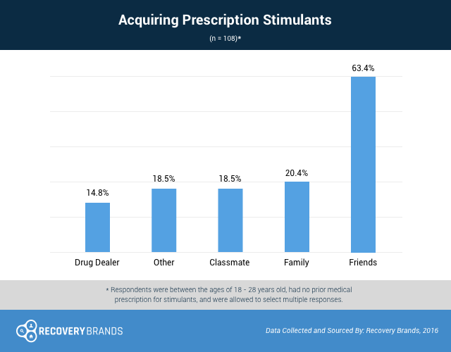

Slide 26
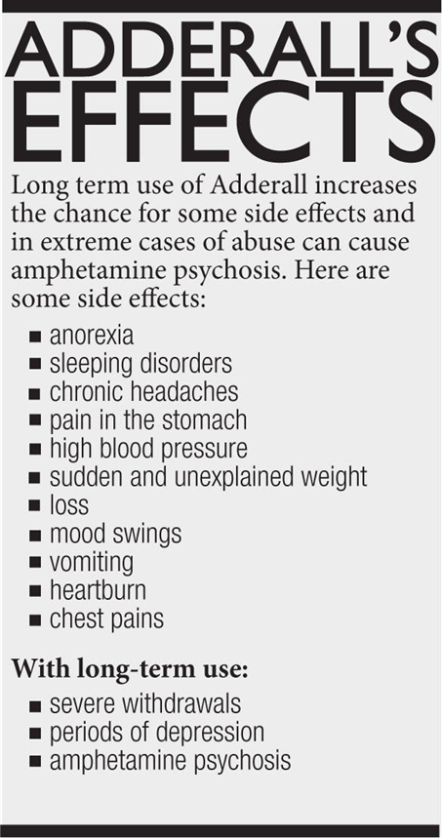
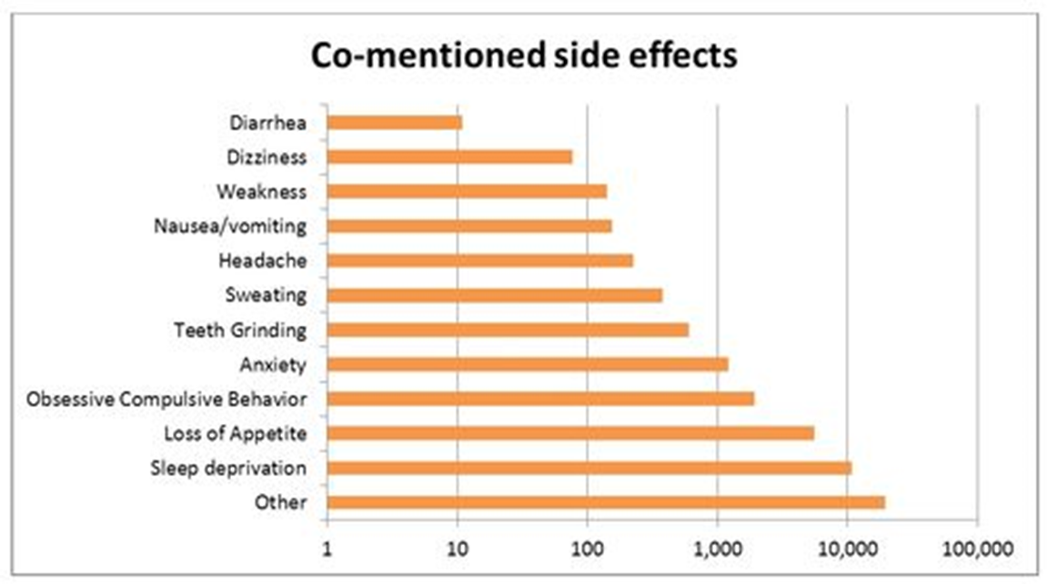
I can control it… it’s safe bc it’s prescribed

Slide 27
So let’s get to know each other… on a chemical level
Why do you do what you do?

Slide 28
How does it work?
Both Adderall and Ritalin are central nervous system (CNS) stimulants. They work by increasing the availability of the neurotransmitters norepinephrine and dopamine in your CNS connections. This speeds up your brain activity. Ritalin works sooner and reaches peak performance more quickly than Adderall does

Slide 29
CNS Stimulant
Combo of
amphetamine-dextroamphetamine
Treatment for ADD/ADHD
Increases
serotonin, dopamine, and norepinephrine
Balances Chemical Imbalances, but…

Slide 30
Diagnosis
Symptoms
Key Players
Dopamine
Serotonin
Norepineprhine
Chemical Imbalances
Determining Factors

Slide 31
The Role of Norepinephrine…
Norepinephrine
NT responds to stress
Increases heart rate, blood glucose, and blood flow to muscle
Triggers flight/fight by increasing alertness, arousal, and speeds up reaction time

Slide 32
The Role of Serotonin…
Serotonin
NT for Mood and Digestion
Created in brain to stabilize mood and anxiety, but mostly in stomach.
NT controls sleeping, eating, and digestion
Increase in NT will decrease libido, appetite, sleep, and will increase nausea

Slide 33
The Role of Dopamine…
Dopamine
The Happy NT
In charge of the “Reward Zone” which regulated how you perceive experience and pleasure
Increases focus and attention because primal instinct to aid with memory. (food, sex, etc)
If you enjoy something, then dopamine increases, which in turn allows you to remember information

Slide 34
Dopamine continued…..
It enhances concentration, boost mood, and have a pro-social effect
Dopamine also helps with fine motor functions.
Adderall increases the amount of dopamine available in the brain, despite limited amounts of receptors.
High levels can cause: Agitation, Feelings of pleasure, High Energy, Anxiety, Cognitive Acuity, Hyperactivity, Insomnia, Learning, Mania, Paranoia, Stress, Social Seeking.
Adverse Reactions to High Levels: Aggression:, Bizarre posturing, Delusions, Digestive tract problems, Hallucinations, Muscle twitching, Nausea, Salivation, Suspicious thinking:

Slide 35
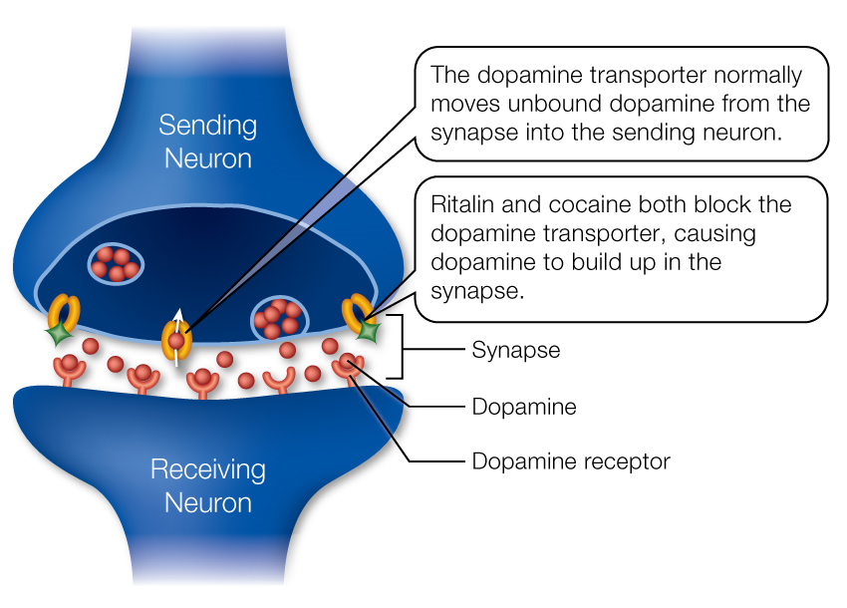

Slide 36
The Final word
The accumulation of dopamine in the brain makes it continue to create new dopamine receptors. Over time, the brain adapts and dopamine stops having the same effect as it did originally, which causes us to search/use for more of what we crave.
This effect is called tolerance.
However, now there are more receptors, you won’t find that same “high”.

Slide 37
The hard questions
Is it cheating? (doping?)
If we exchanged the drug “Adderall” with another schedule 2 drug, methadone, and it shares similar effects, will it be received just the same?
How can we differentiate between therapeutic use and dependence/abuse?
What do we do if we see someone selling/ingesting Adderall?
Appears to be overdosing?

Slide 38
Consequences
Mixing Adderall with Alcohol
  Severe risk
  Adderall disguises some of the common signs of excessive alcohol consumption like slurred speech and lethargy, it is very easy to experience alcohol poisoning without noticing the warning signs leading up to it.
  Both Adderall and alcohol have dehydrating properties.
  Alcohol is a depressant, which can further exacerbate potential issues associated with withdrawal.
Effects: Increased body temperature, High blood pressure, Rapid heart rate, Cardiac complications, Seizures, Stroke, Sudden death.

Slide 39
Withdrawals
Mild:
  NVD
  Blurred vision
  Stomach Cramps
  Aches and Pain
Serious:
  Hypertension
  Seizure
  Vision Loss
  Kidney/Liver Damage

Slide 40
Help and rehab
Inpatient/residential: Anywhere from 30 days to 90 days or longer.
Outpatient . This type of treatment does not involve living at the rehabilitation program.
12-step programs. Twelve-step programs such as Pills Anonymous
Dual diagnosis. Dual diagnosis facilities can treat an Adderall addiction in addition to any mental health problems you or your loved may be struggling with.
How to Pay
  Insurance
  MSAMHSA (Substance Abuse and Mental Health Services Administration’s helpline): 1-800-662-HELP (4357),

Slide 41
To Sum it up…
Humble Beginnings:
-Benzedrine(cold/asthma) to Dexedrine(depression/diet) to Speed(Party) to Adderall(ADHD/Study Buddy)
Perspective:
-The same pills that are now prescribed to children suffering from ADHD were once taken by military pilots attempting to stay awake to fight the Nazis.
-They were taken by depressed housewives trying to stay thin.
-By 60’s hippie drug addicts experimenting with different psychoactive states.
Who knows what they will next be used for, but it is safe to say that amphetamines are here to stay.

Slide 42
Thoughts to end with
ADHD and other chemical imbalances are real, but so is dependency, abuse, and addiction.
Education and awareness is key.
As a parent/teacher, have that open dialogue.
As a student/someone taking Adderall, seek medical advice and educate self on benefits and consequences.
For further questions or concerns, please come by the GCC Health Center.
Powerpoint will be available on our website.

Slide 43
Resources
https://www.attn.com/stories/2000/history-amphetamines-united-states
https://drugabuse.com/featured/rise-of-the-study-drug-adderall/#.Wv3XfU2Wyzc
http://www.center4research.org/study-drug-abuse-college-students/
https://www.addictioncenter.com/stimulants/Adderall/
https://www.dea.gov/druginfo/ds.shtml
https://blog.cognifit.com/functions-of-dopamine-serve-you/
https://mentalhealthdaily.com/2015/04/01/high-dopamine-levels-symptoms-adverse-reactions/
Twitter, #adderall
Instragram, #adderall

