Slide 1
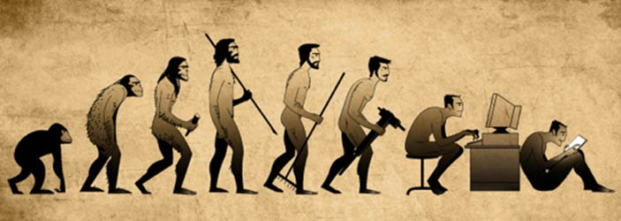
Tech-Proof Your Posture
Do your homework and get rid of the hunch!

Slide 2
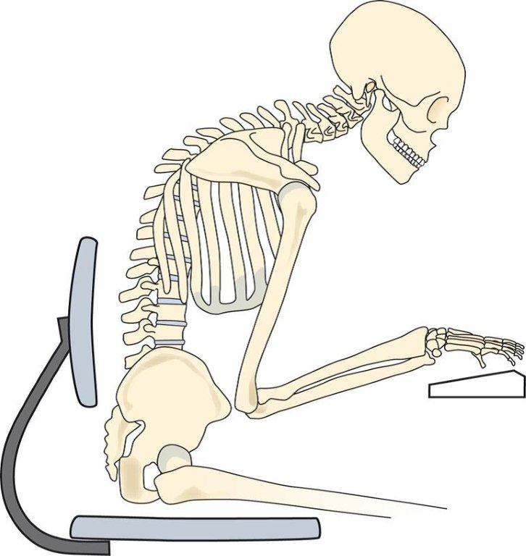
Why is posture important?
The human body is “plastic”
  Chronic positions and repetitive movements cause adaptations in the neuromuscular system
  Sub-optimal positioning can lead to
    muscle imbalances (overactive and underactive muscles)
    altered movement patterns
    trigger points
    chronic muscle pain/soreness
    chronic injuries

Slide 3
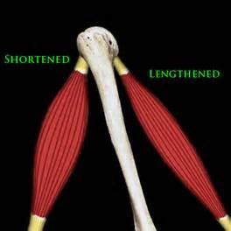
What is a muscle imbalance?
Overactive, tight or shortened muscles on one side of the joint
  Overactive doesn’t necessarily mean “strong”
Underactive, lengthened or weak muscles on the other side of the joint
An active muscle on one side of the joint tends to inhibit the antagonist muscle on the other side (reciprocal inhibition)

Slide 5
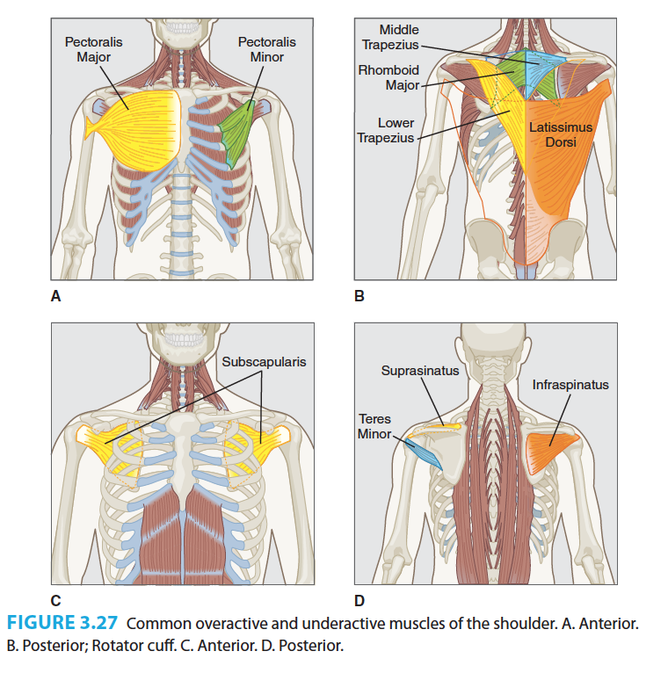
Commonly OVERACTIVE
Latissimus Dorsi
Pectoralis major/minor
Commonly UNDERACTIVE
Middle/lower trapezius
Rhomboids
Rotator cuff muscles (SITS)

Slide 6
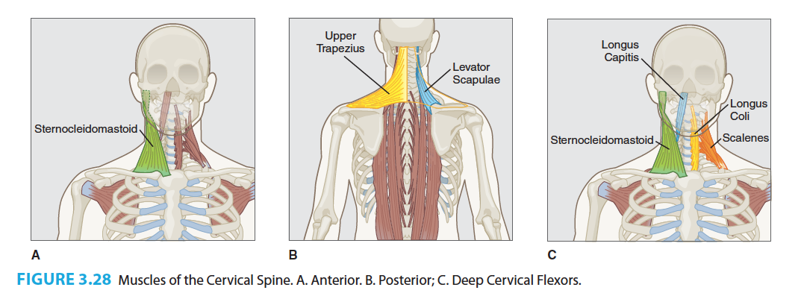
Commonly OVERACTIVE: Upper trapezius, sternocleidomastoid and levator scapulae
Commonly UNDERACTIVE: deep cervical flexors (longus capitus and longus coli)

Slide 7
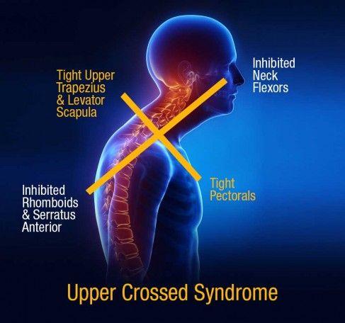
Upper Crossed Syndrome
(picture doesn’t include all muscles involved)
Usually we don’t know which comes first – the poor posture or the muscle imbalance
To correct it, we have to address both!

Slide 8
Step 1: Address overactive muscles
Inhibit overactive or tight muscles with:
  SMR/rolling
  Stretching
Muscles targeted:
  Chest (pecs)
  Back (lats)
  Neck (upper traps/levator scapulae)

Slide 9
Step 2: Address underactive muscles
Activate + strengthen + improve endurance
Isolated exercises
Multi-joint exercises
Muscles targeted:
  Mid-back (rhomboids, and mid/lower traps)
  Rotator cuff
  Neck flexors

Slide 10
Step 3: Teach your body a new way to sit/move
Step 1 & 2 won’t last unless we make it permanent!
Educating the neuromuscular system = changing the way we move
Practice posture and movement patterns
At first, it may be awkward, but eventually should become relaxed
Don’t overdo it (and cause another compensation!)

Slide 11
Let’s move!
What you need:
  Mat
  Foam roller
  Tennis ball
  Wall
  Partner

Slide 12
Foam Roller T-Spine Mobility
Extend the upper back over the foam roller slowly.
Repeat 2-3 times.
Move to the next vertebrae.
Start at the bottom of the rib cage and end at the top of the shoulder blades.
For more intensity, bring the elbows together.

Slide 13
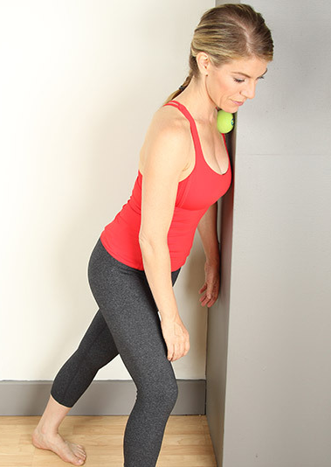
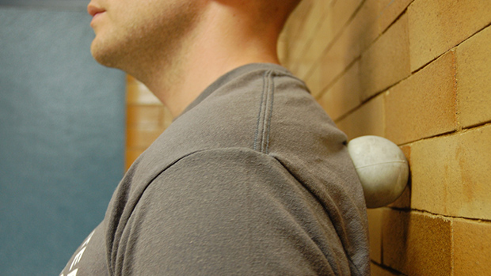
Rolling the pecs and traps/levator scapulae
Roll slowly and hold any tender points for 30-90 seconds
Pectorals
Levator Scapulae

Slide 14
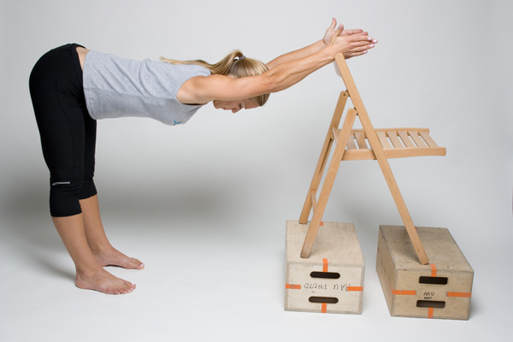
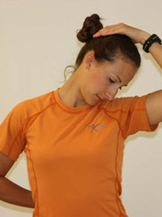
Static Stretches
Hold 30 sec
Twisting Stretch for pecs
or t-spine mobility
Latissimus Dorsi Stretch
Levator Scapulae Stretch

Slide 15
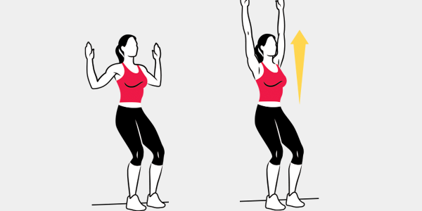
Dynamic Stretches
5-10 reps
Wall Slide
Quadruped Thoracic Rotation

Slide 16
“Ironman”
Focus on keeping the shoulders away from the ears
10 reps, hold each rep 2-5 seconds

Slide 17
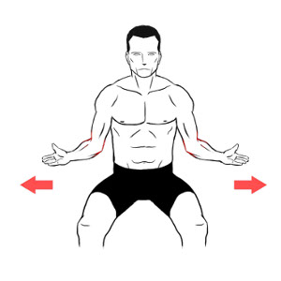
Arm External Rotation and Chin Tuck
10 reps, hold each rep 2-5 seconds

